Slide 1








CSUBUY Procure‐to‐Pay (P2P)
Chart of Accounts and Account Code Training

Slide 2

Agenda
Topic
Default Settings
Commodity Codes
Chart of Accounts
Account Code Overrides
Q&A

Slide 3
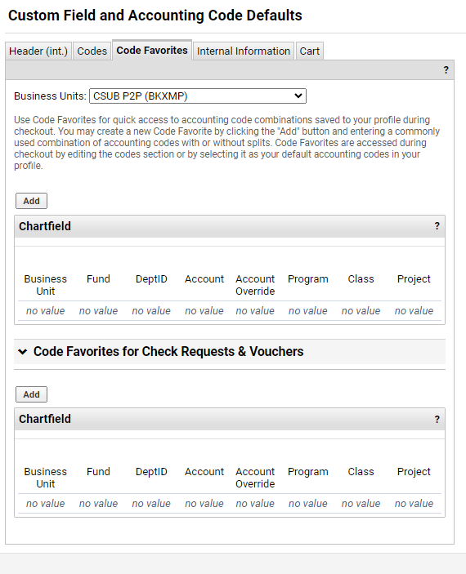
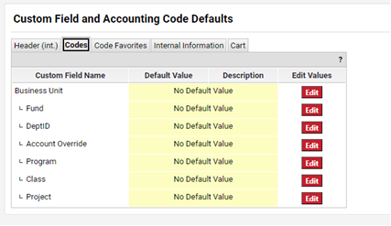
Default Settings
Users can set up Code Favorites, however, it is not recommended unless all lines in your requisition have the same commodity codes.
Do not use Accounting Code Defaults.

Slide 4
Commodity Codes
Commodity Codes will populate the Account codes once requestor hits “Proceed to Checkout.”
It is important (especially for punchout suppliers like Amazon and Staples) to review your Commodity Codes and make any necessary changes before proceeding to checkout.

Slide 5
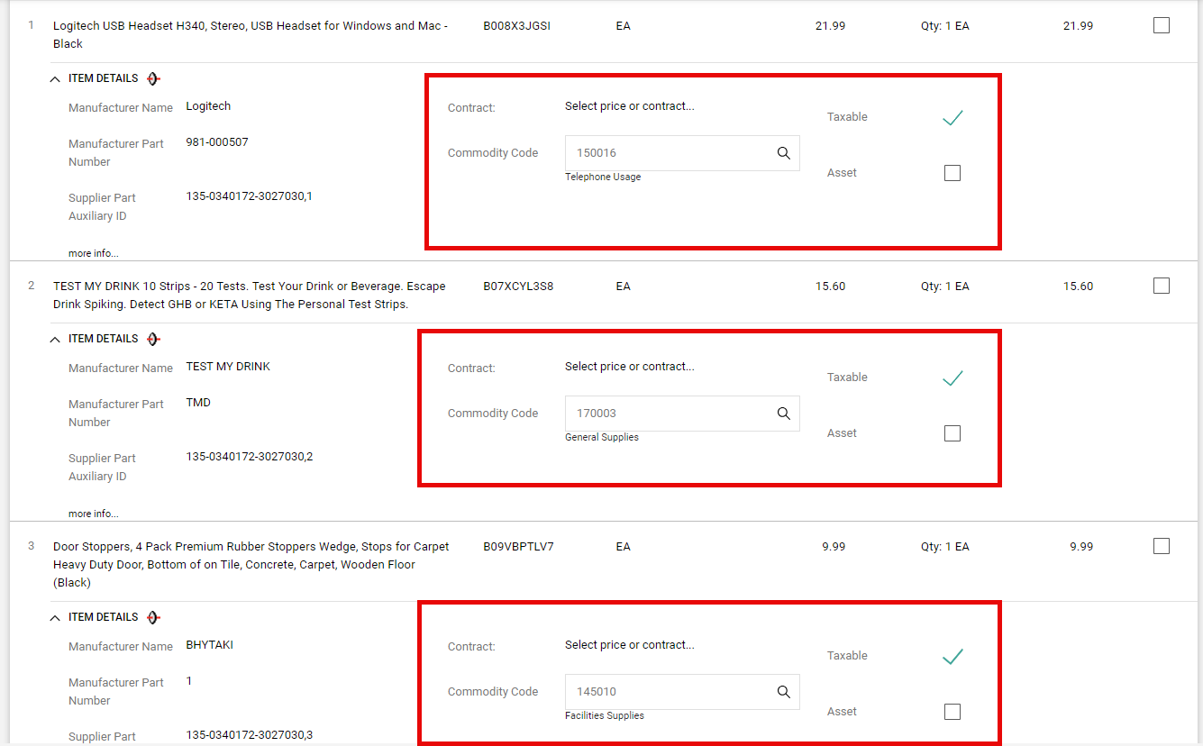
Reviewing Commodity Codes
Review Commodity Codes for accuracy.

Slide 6
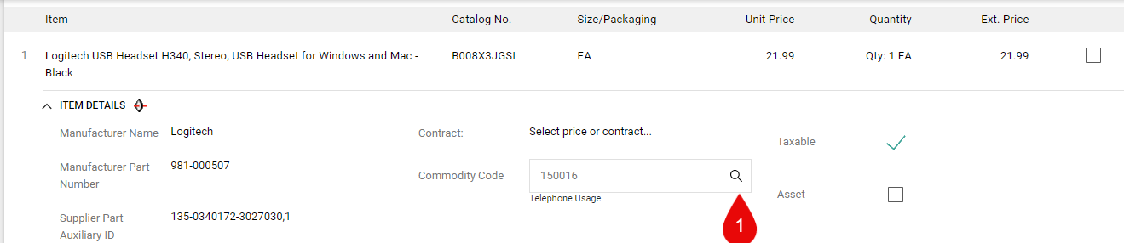
Reviewing Commodity Code Step 1
Click the magnifying glass.

Slide 7
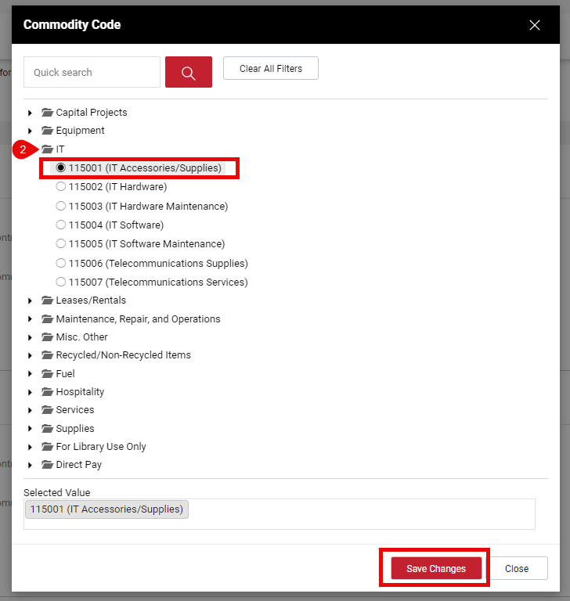
Reviewing Commodity Codes Step 2
Click the folder to open the Commodity Codes options, select the correct Commodity Code and press Save Changes.

Slide 8
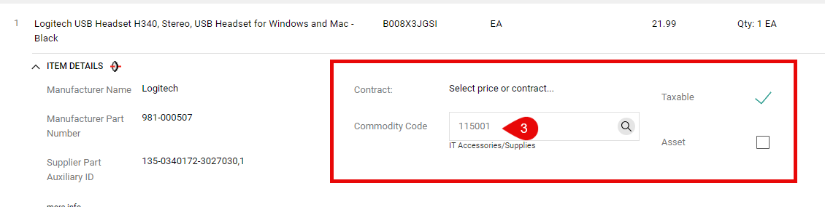
Reviewing Commodity Codes Step 3
Commodity Code is then updated.

Slide 9
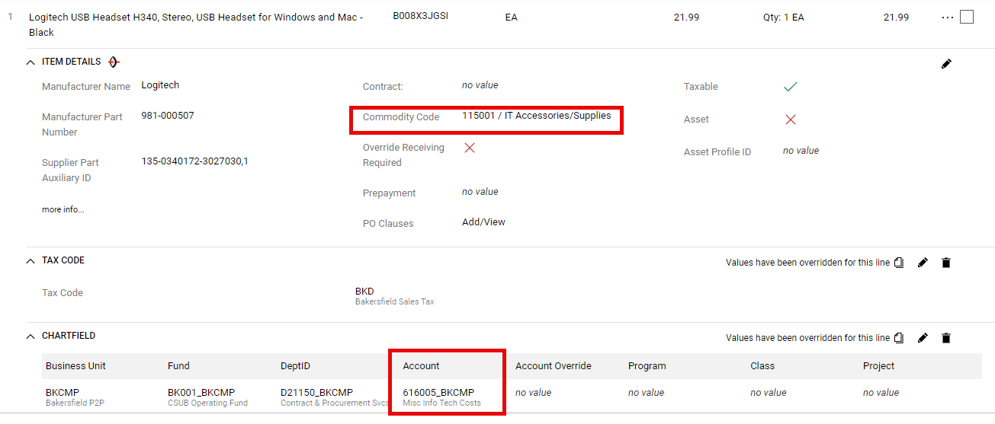
Reviewing Commodity Codes Step 4
At Checkout, the Account Code is populated based on the Commodity Code.

Slide 10
Chart of Accounts - Chartfield Structure
Chartfield String Order (Where, Who, What):
*Business Unit (Which organization?)
BKCMP, BKASI, BKFDN, BKSPA, BKSTU
*Fund (Where is the funding source?)
*Department (Who is responsible for transaction?)
*Account (What is the nature of the transaction?)
Program
Project Not required, but may help with tracking transactions for reporting.
Class
*Required chartfields on all transactions

Slide 11
Chart of Accounts – Account Code Overview
The function of accounts is to classify a transaction as an asset, liability, reserve, revenue, or expense. It identifies “what” type of transaction is being recorded. Account codes are shared among all business units.
Account Types
Assets → Begin with 1
Liabilities → Begins with 2 Only used by BAS/Financial Services
Reserves/Fund Balance → Begins with 3
Revenues → Begins with 5
Expenses → Begins with 6

Slide 12
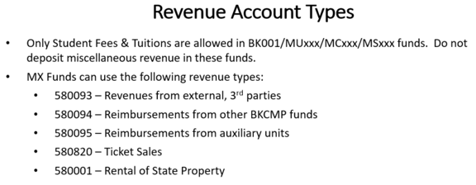
Chart of Accounts – Account Code Overview
Which account code to use when making a purchase, ordering services, or reimbursing expenses:
Always use an Expense code that begins with 6.
Which account code to use when collecting fees, ticket sales, other revenues from external 3rd parties.
Always use a
Revenue code that
begins with 5.
Which account code to use when refunding a transaction?
Use same account code as original transaction.

Slide 13
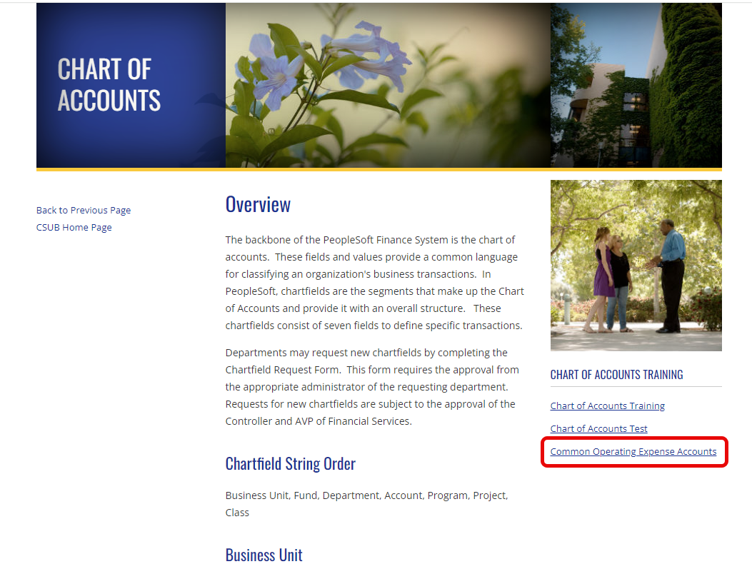
Chart of Accounts – Account Code Overview
Not sure which account code to use?
Use list of Common Operating Expenses.
Send questions via email to accounting@csub.edu.

Slide 14
Account Code Overrides
All Account Code Overrides will need approval from Accounting & Reporting Directors.
Account codes may require additional explanations/justification from user.
  Requisition will be returned to User with comments.
  User will need to send an email explaining the justification for account override.
Do not override account code unless code generated from commodity code is incorrect. Best option is to change commodity code.
  Example: Custodial Supplies → 660003-Supplies & Services.
Do not override account code to match account code used in previous years.
Do not override account code to match budget line or balance.
  Submit budget transfer, if preferred.

Slide 15







Q
A
&

