Slide 1
Undergraduate Program
Preceptor Orientation
California State University, Bakersfield
(CSUB)

Slide 2
Mission Statement
Mission of the Department of Nursing is to provide a collaborative and interactive learning environment committed to excellence in teaching, scholarship, service, and practice.
Nursing faculty provides nursing education to undergraduate and graduate students seeking entry into professional nursing or advanced education.
The Department of Nursing fosters mutual collaboration with the community of interest

Slide 3
Mission Statement
Graduates will have acquired knowledge, skills, attitudes, and values essential to the practice of professional nursing.
Professional nurses will make autonomous and collaborative judgments in a variety of healthcare situations and are accountable for their practice.
Graduates will address healthcare issues and needs of their community of interest (Kern County).

Slide 4
Vision Statement
CSUB Department of Nursing will continue to develop as a major contributor to the goal of improving health care delivery in Bakersfield, Kern County and the San Joaquin Valley. The Department will effectively manage its resources to optimize the quantity and quality of RNs required by the region. Through collaboration with local health care stakeholders, CSUB Nursing will find innovative ways to address the growing complexities associated with creating a healthier population in California’s Central Valley.

Slide 5
Department of Nursing Philosophy
Concepts
  Client (person, family, group/aggregate, & community)
  Environment (human, social, political, economic, geographic, & physical factors)
  Health: “A state of maximum wellness (or) functional health status at a given point in time”
  Nurse- “the professional nurse works autonomously and collaboratively with others to promote the health of individuals, families, and communities. Nurses are individually accountable to the public they serve.”
Teaching/Learning Process & Professional Education
  “Learning is an active, experiential process that is lifelong, dynamic, continuous, & growth-producing”
  Students should strive to identify strengths & weaknesses, assume responsibility for learning & actively participate in process
Notes:
Do we need this?

Slide 6
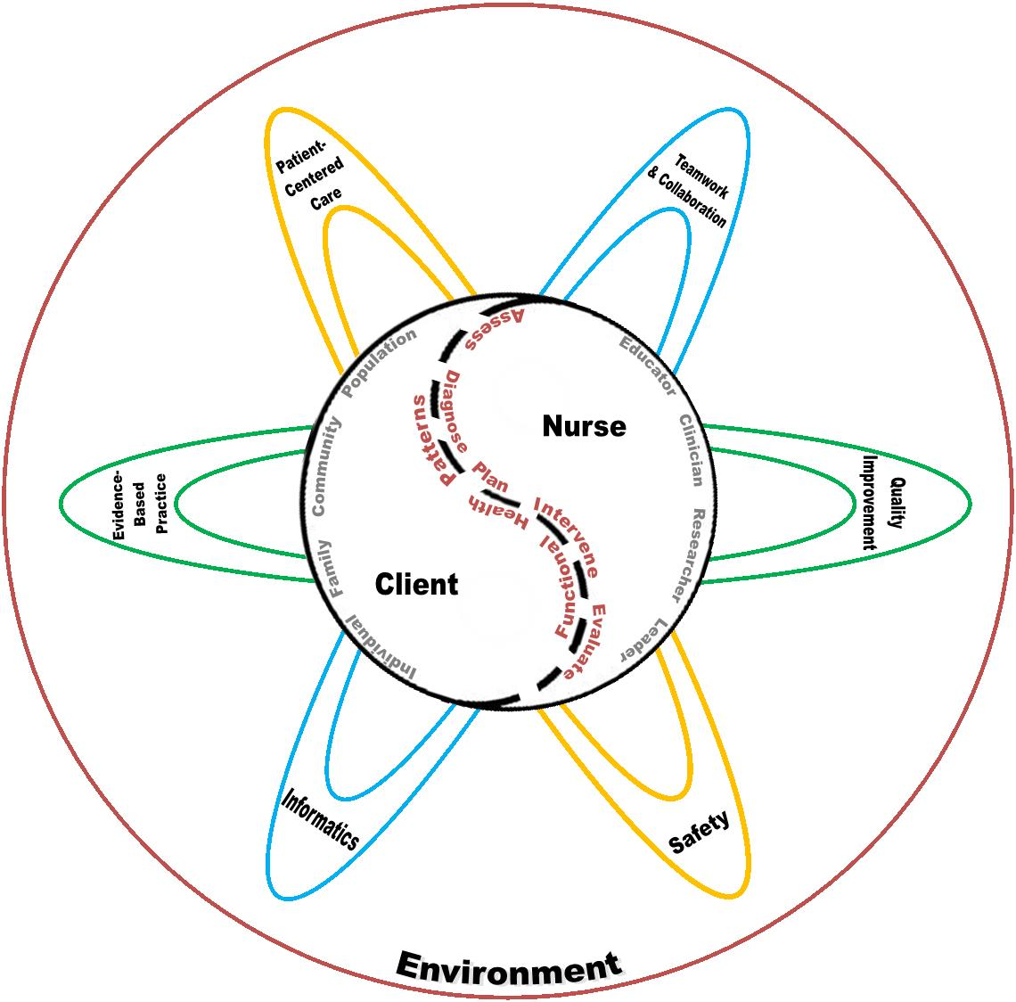
CSUB Department of Nursing
Conceptual Model
Notes:
Do we need this?

Slide 7
Concepts in the Curriculum
1. Clients of Nursing (person, family, group, community)
2. Maximum Functional Status: “goal toward which nursing interventions & care are directed”
3. Nursing Roles (clinician, researcher, educator, leader)
4. Nursing Process (assessment, diagnosis, plan, intervention, evaluation)
Notes:
Do we need this?

Slide 8
Preceptor Program
Definition: The Undergraduate Preceptor Program at CSUB is a component of the Nursing Program that includes a teaching strategy designed to provide nursing students with learning experiences that is guided by an experienced registered nurse who may be an expert in his or her area of specialty.

Slide 9
Preceptor Qualifications
  Preceptors shall be licensed as a Registered Nurse (RN) in the state of California and be employed by a CSUB affiliated health care facility for at least one year.
  The preceptor shall be an RN with a Bachelor of Science in Nursing and/or who is highly experienced in the assigned clinical unit with demonstrated competence in customer relations/communication and clinical nursing skills.
  The preceptor is selected by the nurse manager and is willing and able to teach and serve as a role model for nursing students. S/he oversees the student’s clinical practice in the facility.
  Along with the nursing student, the Preceptor is responsible for the patients for whom the student and the preceptor give care.

Slide 10
Preceptor Qualifications
A relief (alternate) preceptor, who meets the qualifications specified by CSUB Nursing Department, shall be available on the designated preceptor’s days off to:
    Ensure continuity of the student’s precepted learning experience.
    Ensure that a preceptor is present and available on the patient care unit at all times while the student is providing care/nursing services.

Slide 11
Preceptor Qualifications
  Preceptors who have not completed a preceptor course through their facility must complete the CSUB Nursing Preceptor Orientation prior to serving as a preceptor.
  Preceptor Orientation is available at: http://www.csub.edu/nursing/Resources/Preceptor/index.html

Slide 12
Preceptor Program Files
The Preceptor Program files shall be kept in the CSUB Nursing Department office and includes the following information for the designated semester/year assigned:
  Dates of preceptorship
  Preceptor names
  Preceptor’s licensure as RN in California
  Preceptor responsibilities (as designated by the assigned course)

Slide 13
Course Syllabus
Preceptorship
  The course syllabus serves as the written plan for a preceptor course; it provides objectives, evaluation rubrics, and student performance expectations to serve as guidelines for the preceptor.
The syllabus is kept on file in the CSUB Nursing Department

Slide 14
  Selection of Preceptors
  A preceptor is an experienced registered nurse, employed by a clinical facility affiliated with CSUB, assigned to assist and supervise CSUB nursing students during educational experiences that are designed and directed by a CSUB faculty member. At a minimum, the preceptor must meet the requirements for a clinical teaching assistant as described in the CA BRN regulations Section 1425(e).

Slide 15
Selection of Preceptors
As part of the affiliated agreement to assist with student learning experiences, each CSUB affiliated clinical facility identifies preceptors based on CA BRN regulation Section 1425.

Slide 16
Preceptor Assignment
The Course Team Leader facilitates and assigns preceptors for students.
  Clinical Instructor/Student ratio shall not exceed 1:15.
  Preceptor Orientation shall consist of completion of an online PowerPoint course available at: http://www.csub.edu/nursing/Resources/Preceptor/index.html

Slide 17
    Student Evaluation:
    Preceptor Handbook contains the Preceptor Evaluation of Student Performance and Clinical Performance Evaluation Tool forms serve as resources for conveying student performance requirements and course evaluation criteria.
    Preceptor provides input into evaluation of the Nursing student’s performance after each clinical shift to aid in determining the student’s abilities.
    The Clinical Instructor, with input from the preceptor for supportive evidence of ratings, shall be responsible for the midterm and final evaluation of the student.

Slide 18
Ongoing Evaluation of Preceptor Program
  Preceptor Evaluation of Clinical Preceptor Experience: Courses are evaluated each semester by the assigned preceptors.
  Student Evaluation of Preceptor Performance: Each nursing students evaluate their assigned preceptors, as an ongoing evaluation of the preceptor.
  Clinical Instructors will regularly review preceptor performance via evaluation input from students and Clinical Instructors, as an ongoing evaluation of the preceptor.

Slide 19
NURSING PROGRAM OVERVIEW: Department Regulations
Students must attain a grade of ‘C’ or better in all courses required for the major in order to progress in the program. Nursing courses in which students earn less than a ‘C’ may be repeated for credit only once, and this repetition requires departmental consent.

Slide 20
Department Regulations:
Nursing students must carry malpractice insurance in the amount of not less than $1,000,000 per occurrence and $3,000,000 per year to be admitted to clinical courses. The malpractice insurance must be purchased from CSUB.

Slide 21
Department Regulations:
Prior to the first semester of classes, students are required to obtain a Health Clearance form from the Student Health Center. This clearance includes tuberculosis skin testing, physical assessment, immunizations, and drug testing. Flu shots are required.
Prior to the first semester of classes, students must complete a background check.
Student must have current health insurance, or sign a declination form.

Slide 22
Department Regulations:
Students must have access to transportation for their clinical experience.
Students must adhere to the dress code of both the CSUB Department of Nursing and the clinical facility, including a CSUB identification badge.

Slide 23
Preceptor Tips
Be patient. What seems like logical sense for the experienced nurse, can be quite a challenge for students.
Keep your hands behind your back and lips sealed. Allow the student to make the decisions as you watch, unless he/she is proceeding in an unsafe manner.
Make the students use their brains. Do not be too quick to give them the answers (Unless it is a life-threatening situation).

Slide 24
Preceptor Tips
Use guided questioning: allow the student to give you the rationale for an action. Talk the student through decisions and procedures, but ask them, “what do you think you should do?” After they answer, ask them for their rationale. This helps them with their critical thinking ability. Even though it puts them on the spot, in the long run they will benefit.
Seek clinical skills they can perform based on their skills checklist. Not all students have had the opportunity to perform every nursing procedure.
Encourage students to communicate patient status and needs with the physician and other health care professionals.

Slide 25
Preceptor Tips
Have the student give the verbal report to the next nurse and receive report.
Provide plenty of verbal feedback, both positive and negative. Most students want to be told if they have done something wrong.
Complete the Preceptor Evaluation of Student Performance after each clinical shift; the evaluation is a written report of student performance. It will be used in conjunction with the instructor’s evaluation, the student’s self-evaluation, and other assignments to determine the final grade
Have fun and relax, you have a senior Nursing student who is eager to help you during this semester!

Slide 26
ROLES AND RESPONSIBILITIES:
Nursing Student:
Identifies own learning style and learning needs to ensure a successful and positive learning experience for meeting the course objectives.
Develops written Individual Student Objectives and Learning Contract based on self-evaluation (review of clinical course skills checklists and may use the hospital’s/facility’s RN orientation check list).

Slide 27
ROLES AND RESPONSIBILITIES:
  Nursing Student:
  Conveys the learning style to the Preceptor and Clinical Instructor in terms of how the student learns best: visual, auditory, or tactile/kinesthetic; as well as how the student approaches a task (one specific way or through a combination of ways for data input) and the amount of input needed from others.
  Conveys to the Preceptor, the teaching technique(s) that best fits his/her learning style: role model, gatekeeper, advisor, coach/teacher, protector, prescriber, or motivator.

Slide 28
ROLES AND RESPONSIBILITIES:
  Nursing Student:
  Actively pursues opportunities to practice nursing skills/procedures and leadership skills to meet individualized goals/objectives and nursing course objectives.
Collaborates with Clinical Instructor and Preceptor regarding progress during the learning experience to communicate the effectiveness of the experience.

Slide 29
ROLES AND RESPONSIBILITIES:
Nursing Student:
Provides safe, ethical and legal nursing care.
Solicits assistance from preceptor (or other staff member, if appropriate) when needed.
Communicates as required with preceptor and clinical instructor, using contact information and directions provided.

Slide 30
ROLES AND RESPONSIBILITIES:
Nursing Student:
Conducts ongoing, midterm, and final self-evaluation of performance to determine if his/her abilities include the following:
Student Learning Objectives:
  Perform patient-centered care and the nursing roles (clinician, educator, researcher, and leader) at a beginning level of independent professional nursing practice while utilizing the CSUB Department of Nursing Conceptual Model.

Slide 31
ROLES AND RESPONSIBILITIES:
Student Learning Objectives:
  Incorporate legal and ethical responsibilities into each of the nursing roles (clinician, educator, researcher, and leader).
  Collaborate with other members of the interdisciplinary team to promote client (individual, family, group, aggregate, or community) system stability.
  Synthesize nursing research in the professional nursing practice setting, incorporating Evidence Based Practice.
  Apply critical thinking and evaluation skills of a beginning professional leader and advanced beginning clinician in the practice setting.

Slide 32
ROLES AND RESPONSIBILITIES:
Student Learning Objectives:
  Integrate professional behavior as described in specific codes of nursing practice, agency, and departmental policies.
  Formulate a leadership/management project relevant to the practice setting and communicate the findings of the leadership/management project to a professional group and/or faculty.
  Demonstrate the ability to successfully pass a nationally normed test of nursing licensure content (ATI Comprehensive Predictor) or provide evidence of current active RN licensure.

Slide 33
ROLES AND RESPONSIBILITIES:
Clinical Instructor:
Collaborates with the clinical facility to verify the availability of preceptors. The Team Leader identifies the number of preceptors needed based on course enrollment.
Collaborates with the Nursing Student, Preceptor to ensure adequate identification of performance expectations and goals/objectives for the student’s learning experience. This includes assisting with the assessment, planning, implementation, and evaluation of the student’s individualized learning objectives and experiences.

Slide 34
ROLES AND RESPONSIBILITIES:
Clinical Instructor:
Provides guidance and learning materials and/or tools to assist in identifying and meeting the student’s learning needs.
  Serves as a resource to the Nursing Student and to the Preceptor; assisting as needed with the implementation of an action plan to address identified areas for improvement of the student’s performance.

Slide 35
ROLES AND RESPONSIBILITIES:
Clinical Instructor:
Provides reliable contact information to preceptors and students. Maintains availability by phone with prompt message return during each shift that a student is engaging in patient care. Can respond in person, as needed, for emergencies or serious concerns expressed by the preceptor and/or student. Identifies a qualified substitute in advance if unavailable, notifies all students and provides contact information for the substitute.

Slide 36
ROLES AND RESPONSIBILITIES:
Clinical Instructor:
Makes announced and unannounced visits to the clinical site during the semester to meet with the preceptor and the student, evaluate the student’s progress, and address any questions or concerns.
Provides feedback and assigns grades for all required written assignments, Clinical Performance Evaluation Tool Midterm & Final, and on-campus conference participation/performance.
Completes student’s evaluation and determines midterm and final grade, with input from the Preceptor and the nursing student.

Slide 37
ROLES AND RESPONSIBILITIES:
Preceptor:
Assists the student by arranging opportunities and resources to obtain learning experiences appropriate to the course and individual learning objectives.
Sign the student’s Individual Student Objectives and Learning Contract following negotiation for appropriate learning experiences (Preceptor Handbook, forms).
Submit a completed Preceptor Profile and Confirmation of Agreement To Precept forms which includes information on his/her education, qualifications and work experience to be filed in the CSUB Department of Nursing as required by the CA Board of Registered Nursing.

Slide 38
ROLES AND RESPONSIBILITIES:
Preceptor:
Assists the student in his/her orientation to the agency. This includes philosophy, policies, and procedures of the agency and expectations of the student. Examples include dress code, special equipment, emergency situations (fire, disaster, and codes), documentation, charting, medication administration, access to computer system for nursing documentation and retrieval of information, telephone and facsimile use.

Slide 39
ROLES AND RESPONSIBILITIES:
Preceptor:
Maintain sufficient availability during the same schedule as the student. The student will need to match the preceptor schedule rather than the preceptor accommodating the student’s schedule. In rare situations, the preceptor may designate another agency member to assist the student. Designee must be an RN with sufficient experience to assist the student.
Sign the Clinical Time Sheet verifying student attendance (Preceptor Handbook).
Complete Preceptor Evaluation of Student Performance at the end of each shift

Slide 40
ROLES AND RESPONSIBILITIES:
Preceptor:
Provide ongoing and culminating evaluation of the student’s performance to the student and the assigned Clinical Instructor (see Individual Student Objectives and Learning Contract, Clinical Performance Evaluation Tool and Preceptor Evaluation of Student Performance).
Meet with the student during or at the end of shift to discuss and document student achievement or lack of achievement of clinical objectives and individual student learning objectives. This is documented on the weekly Preceptor Evaluation of Student Performance (Preceptor Handbook).

Slide 41
ROLES AND RESPONSIBILITIES:
Preceptor:
Notify the student and Clinical Instructor at any time during the course that clinical or individual learning is not being met or when a student is not making sufficient progress toward achieving the course and/or individual objectives.
Evaluates the student’s learning, in conjunction with the Clinical Instructor, based on the course and individual learning objectives. Completes the “Preceptor Evaluation of Student Performance” form at the end of each completed shift.

Slide 42
ROLES AND RESPONSIBILITIES:
Preceptor:
Evaluate the preceptor experience for the course.
Submit a completed evaluation of the course (Preceptor Evaluation of Clinical Experience) to be filed in the CSUB Department of Nursing as required by the Board of Registered Nursing.

Slide 43
Dress Code Policy
CSUB nursing students must follow CSUB and agency policy regarding uniform dress and professional behavior.

Slide 44
Dress Code Policy
CSUB nursing students represent the University and the Department of Nursing when interacting with patients, their families, staff, and others in the health care environment. The way students dress demonstrates respect for the University they represent and for the patients and families they serve. Students purchase and wear the uniform of the Nursing Department throughout their clinical experience, unless the clinical instructor and/or preceptor advises otherwise. While wearing the CSUB uniform, students are clearly recognized at the University and by the clinical agencies accommodating the student experience.

Slide 45
Dress Code Policy
Professional attitudes and clothing reflect the same respectful behavior and professional attitudes even when the CSUB uniform is not required in the clinical area. Information regarding uniform purchase is provided during orientation. Uniform purchase, including the polo shirt worn during community health experiences, is mandatory. Students who fail to purchase their uniform in a timely fashion will be dropped from clinical courses.

Slide 46
Dress Code Policy
The uniform top is light blue and includes the monogrammed CSUB Department of Nursing logo (with optional first name).
This uniform’s pants are a regulation type of opaque white or light blue (the same color and fabric as the traditional top and lab jacket) with straight leg pants (men or women), or knee to mid-calf length skirts or culottes (women only). Women students must wear pantyhose with skirts. Only a regulation blue CSUB lab coat with the CSUB monogrammed Department of Nursing logo with optional student first name may be worn over the uniform. Appropriate undergarments must be worn and must be covered by the uniform. Students may wear a white T-shirt under the uniform if desired.

Slide 47
Dress Code Policy
Casual attire, such as shorts, jeans, thongs, or short midriff tops are not permissible in the clinical setting at any time. Clinical Instructors may have additional requirements for specific clinical areas. Please clear any exceptions to these items with your Clinical Instructor.

Slide 48
Dress Code Policy
Identification Badge
  The CSUB Identification badge includes: student picture, student name and title “Nursing Student” in a minimum of 18-point font. This complies with the CA Board of Registered Nursing requirement. The identification badge must be worn above the waist. The identification badge must be worn at all times during clinical hours at agencies.

Slide 49
Dress Code Policy
Footwear - Wear clean white, navy blue, black or dark brown shoes with closed toe and heel, with nonskid soles of nonporous material. Be sure shoe laces are white and clean. Women wear white or beige hose or solid white socks.
Hair
  Hair is neatly maintained, clean and kept off the collar. Hair is pulled back to prevent it from falling forward over the face while performing routine nursing duties. Any extreme look or color is not permitted. Plain barrettes or combs are allowed.
  Men may choose a neatly trimmed mustache or beard. Facial hair is maintained in short style to insure adequate seal for respiratory isolation masks/particulate respirators. No handle bar style mustaches or long beards are acceptable.

Slide 50
Dress Code Policy
Makeup: Makeup is fresh and natural. Extremes in color, glitter, or amount are not acceptable.
Nails: No acrylic nails, extenders, polish or long nails are permitted. Hands and nails are clean and free of any stains.
Perfume: Close contact with patients and staff requires students not wear fragrance/perfume or after- shave.
Sunglasses: Sunglasses may be perceived as blocking interpersonal communication. Do not wear them indoors; however, polarized glasses that tint light gray in bright light are acceptable.

Slide 51
Dress Code Policy
Jewelry
  The following jewelry is allowed:
    a) One small post earring (with no dangles) in each ear;
    b) One small ring;
    c) Small necklaces and neck chains inside the uniform;
    d) ankle chains that are not visible or audible; and
    e) small wrist watches with second hands.
  No other jewelry and/or visible body piercing is allowed in the clinical area. (Please do not assume because the pierced ornament is in your tongue that it is invisible. It is not acceptable professional dress).

Slide 52
Dress Code Policy
Tattoos - No visible tattoos are permitted. Cover any tattoos that may be visible.
Hygiene - Personal hygiene must be of high standards. Absence of body, mouth and clothes odor is necessary. Do not chew gum or smokeless tobacco while in clinical areas. Students may smoke only in the designated areas during assigned meal or break time.
Exceptions - Requests for exceptions must be submitted to the Clinical Instructor and/or agency in writing a minimum of five working days prior to the day of the clinical experience.

Slide 53
Dress Code Policy
The guidelines, established by CSUB students and nursing faculty, will be enforced for all students in the Nursing program.
Any student failing to comply will be asked to leave the clinical area and may not return until modifications are made. This action will result in an unexcused absence for the day. Any desired deviation from this code must be presented to the Clinical Instructor for consideration.
Students should be aware that additional dress restrictions and infection control policies might be required in specific departments of agencies or hospitals.

Slide 54
Required Forms are available in Preceptor Handbook
Preceptor Profile Form
  Fill out and return, in the Preceptor Handbook
Confirmation of Agreement to Precept
  Fill out and return, in the Preceptor Handbook
Preceptor Evaluation of Clinical Preceptor Experience
  Preceptor fills out and returns at the end of the semester, in the Preceptor Handbook
Student Evaluation of Preceptor Performance
  Students fill out, in the Preceptor Handbook

Slide 55
Required Forms for are available in Preceptor Handbook
Clinical Time Sheet:
    - Students fill out and preceptor signs
Written Notice to Clinical Instructor of Clinical Setting and Calendar of Clinical Hours
    - Students fill out and return to faculty
Preceptor Evaluation of Student Performance (for each completed shift)
  - Preceptor fills out and reviews it with the student at the end of each completed shift

Slide 56
Individual Student Objectives and Learning Contract
Individual Student Objectives and Learning Contract:
  Students prepare attainable objectives that have been approved by their Clinical Instructor. The students then have them approved by their preceptor at the beginning of the semester.
  Preceptor, Student, and Clinical Instructor sign the Individual Student Objectives and Learning Contract.

Slide 57
Individual Student Objectives and Learning Contract
Students are evaluated formally using the Preceptor Evaluation of Student Performance at the end of each completed shift.
The Clinical Performance Evaluation Tool, Individual Student Objectives and Learning Contract:
  Evaluated at Midterm
  Final Evaluation is done at the end of the required shifts, at a minimum of 75 hours

Slide 58
Thank you!
We appreciate your support of our nursing program and our students
If you need assistance or have questions please contact:
  Course Team Leader
  (661) 654-2505

