Slide 1


OmniCMS Training
Derek Chaney
Campus Technology Trainer
csub.edu/training
training@csub.edu

Slide 2

Session Goals
Overview of on-demand training resources from Omni
Basic demonstration
Q & A

Slide 3
Sandbox Link
Log in with NetID and Password
omni.csub.edu

Slide 4
Training Resources From Omni
Omni CMS Support Site
https://support.moderncampus.com
Full documentation
Step-by-step tutorials
Video tutorials
Training Tuesdays
Training Department E-mail
training@moderncampus.com

Slide 5
Training Resources From Omni
Full Library of training videos from Omni
https://support.moderncampus.com/videos.html

Slide 6
Training Resources From Omni
Training Tuesday
https://support.moderncampus.com/learn-omni-cms/webcasts/training-tuesday.html

Slide 7
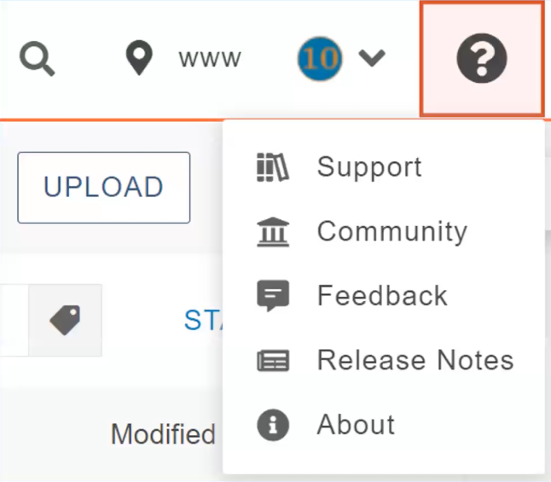

Slide 8
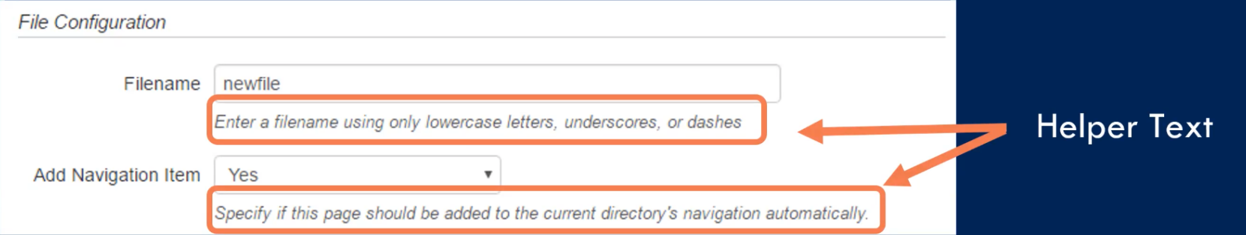

Slide 9
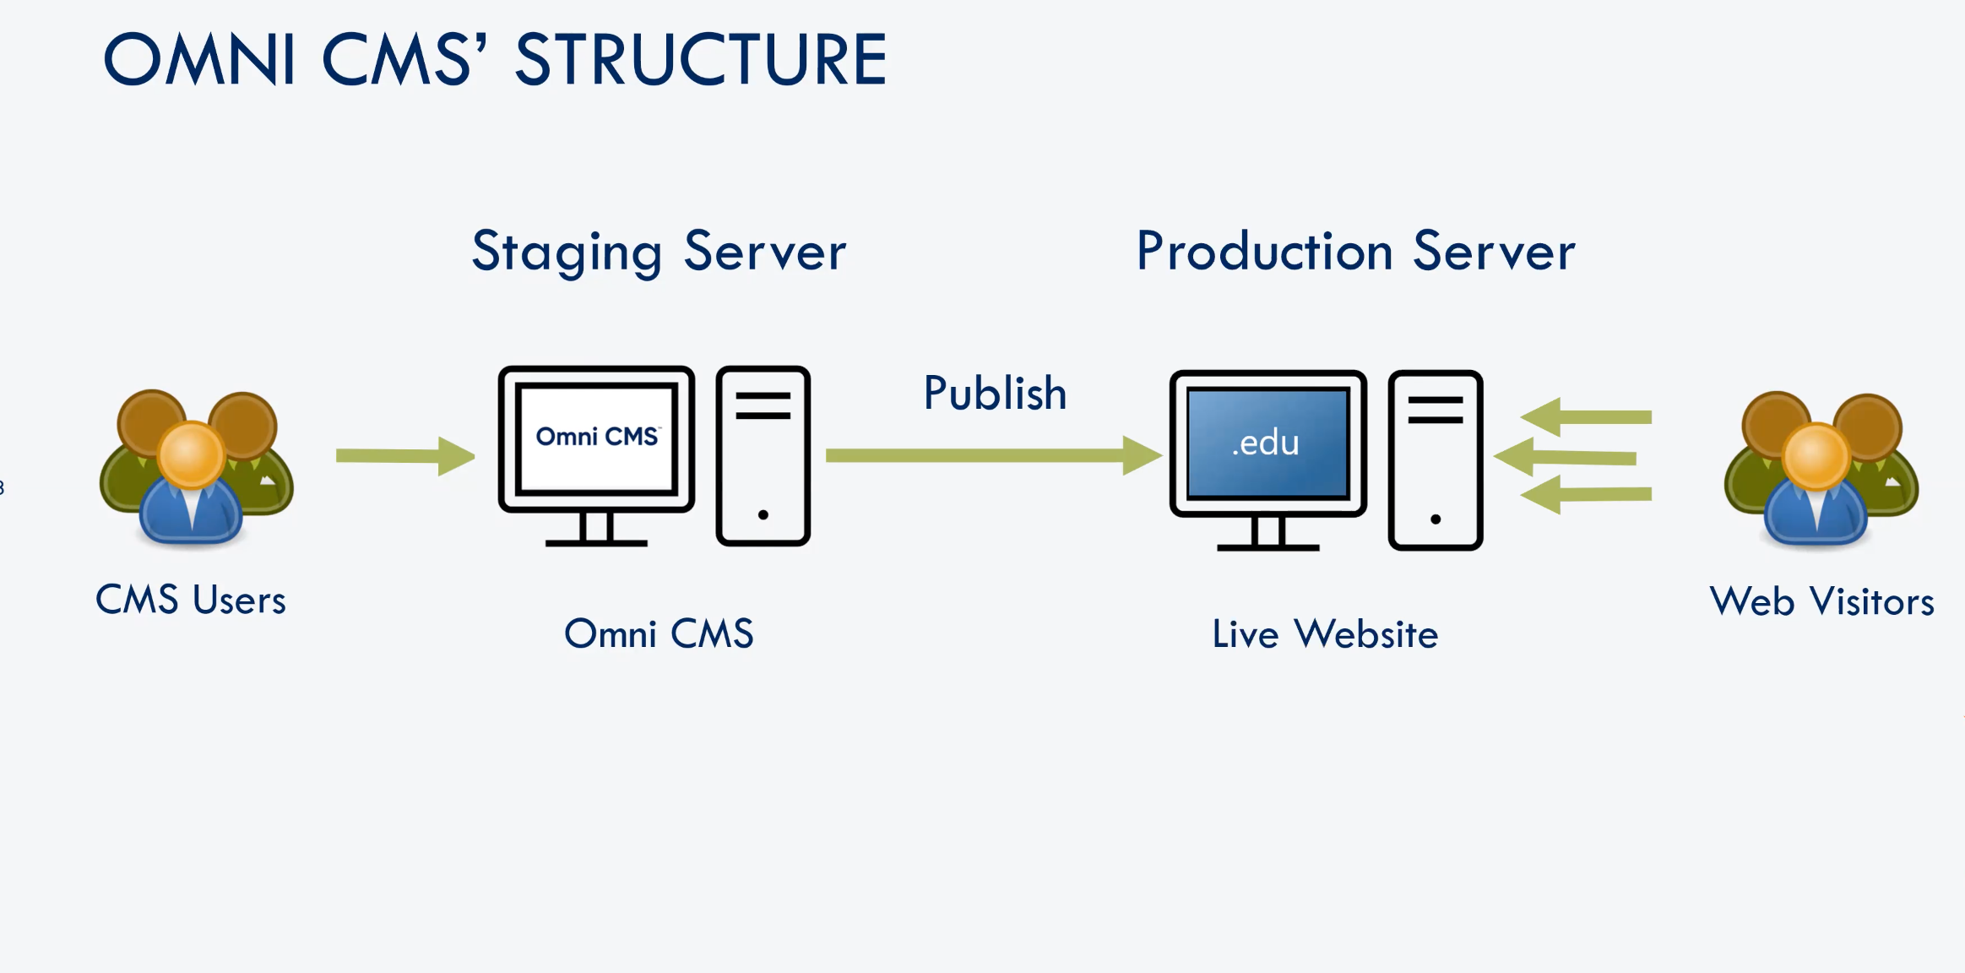

Slide 10
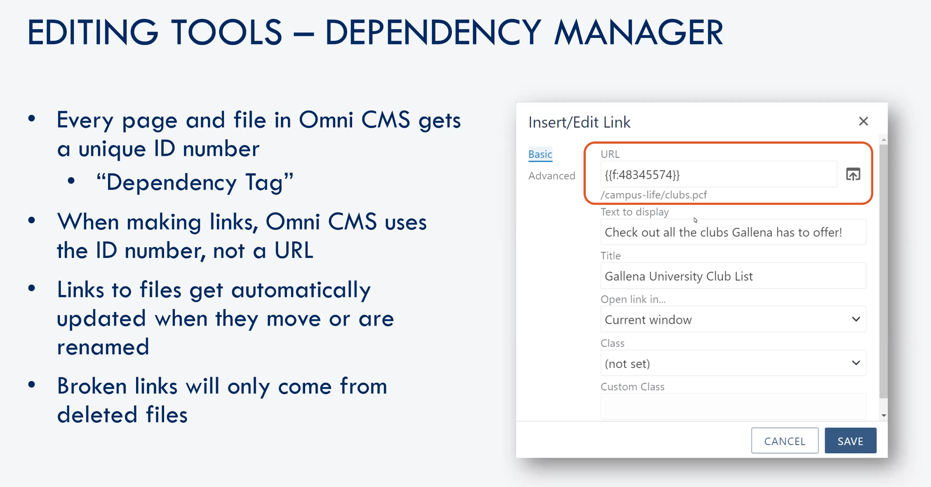

Slide 11
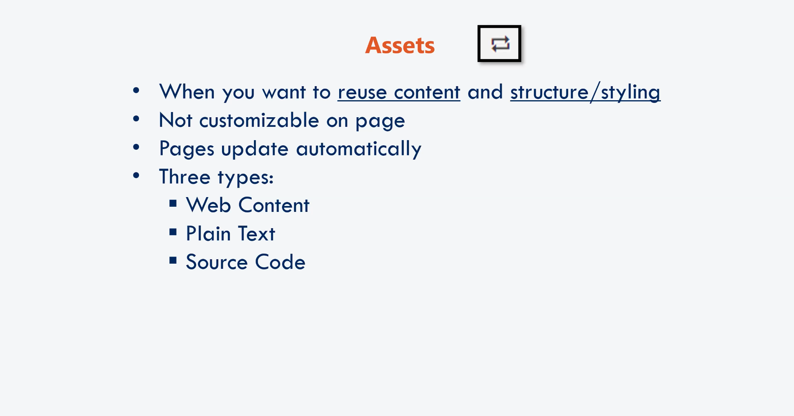
Reusable Content

Slide 12
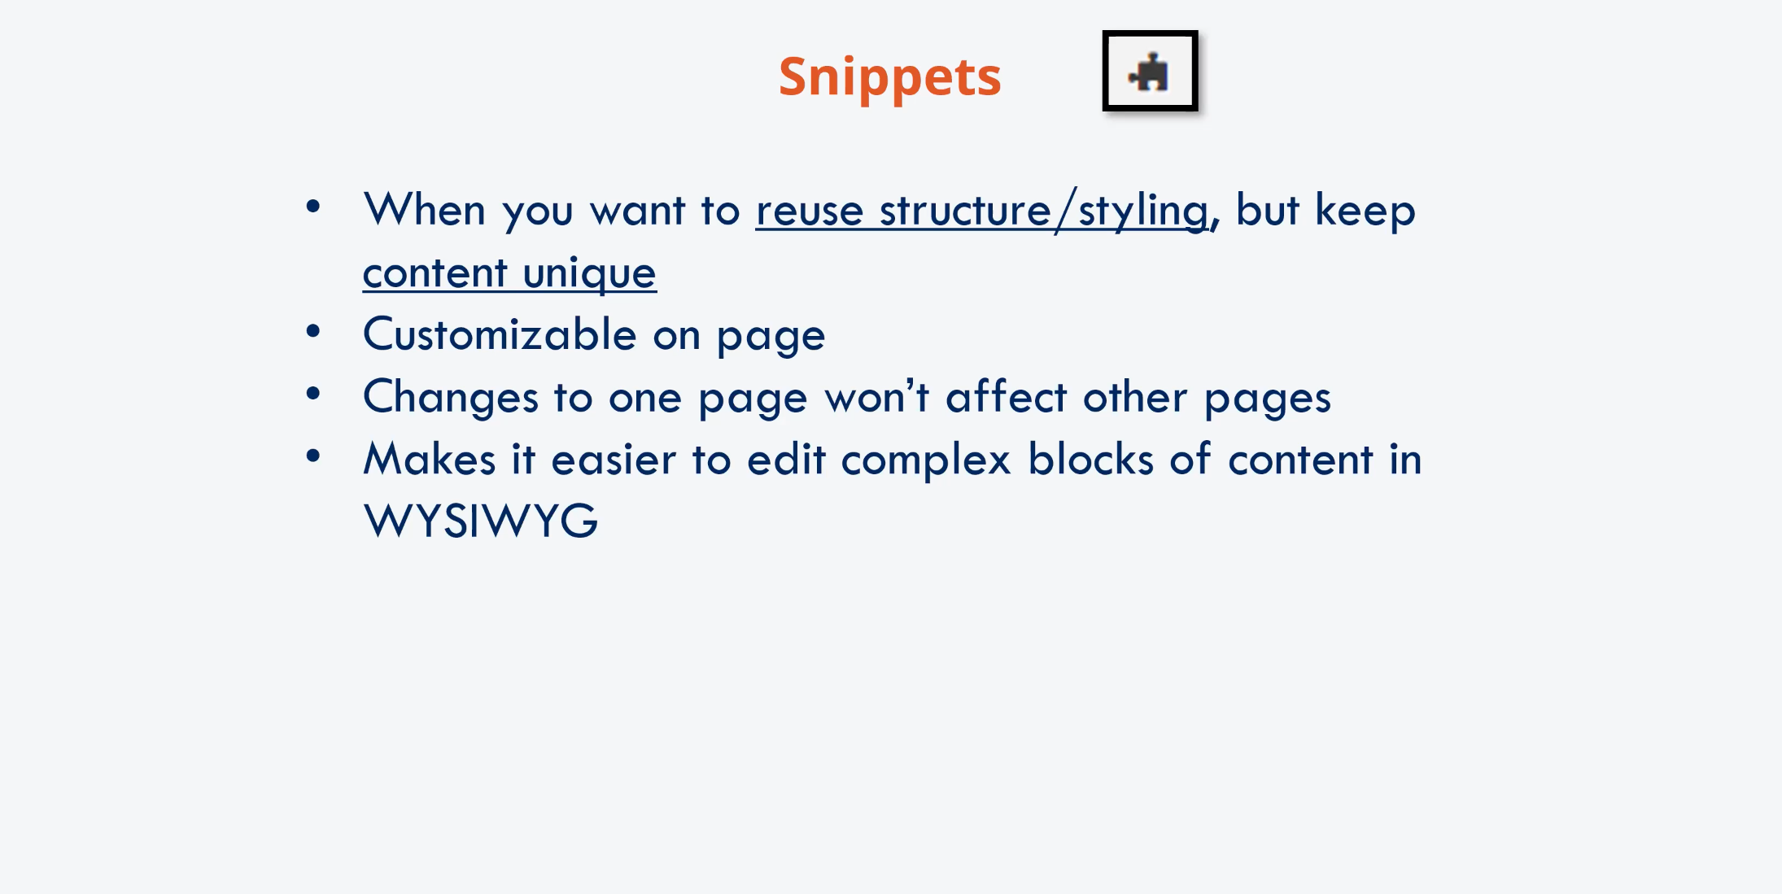
Reusable Content

Slide 13
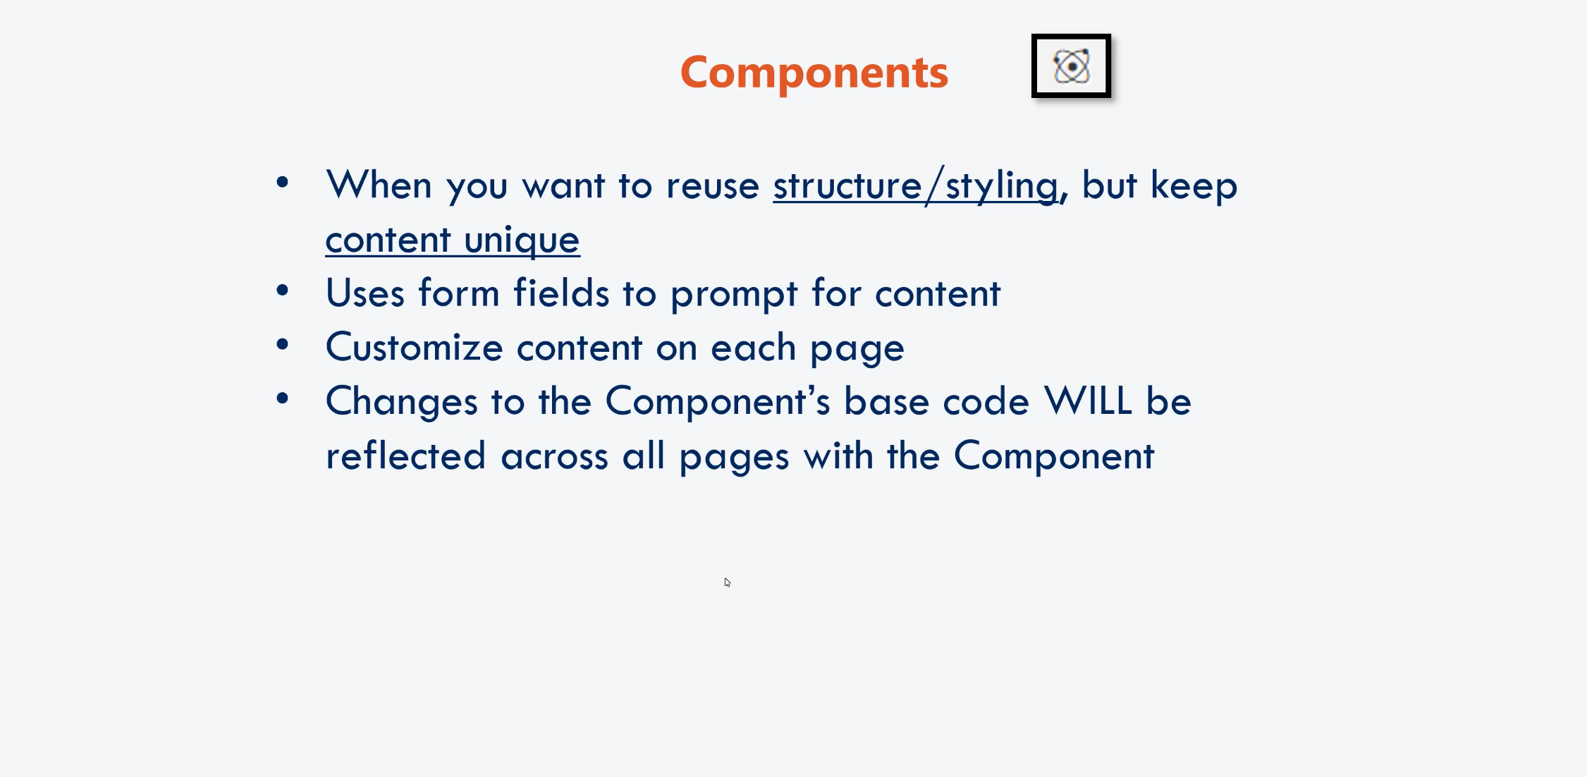
Reusable Content

Slide 14
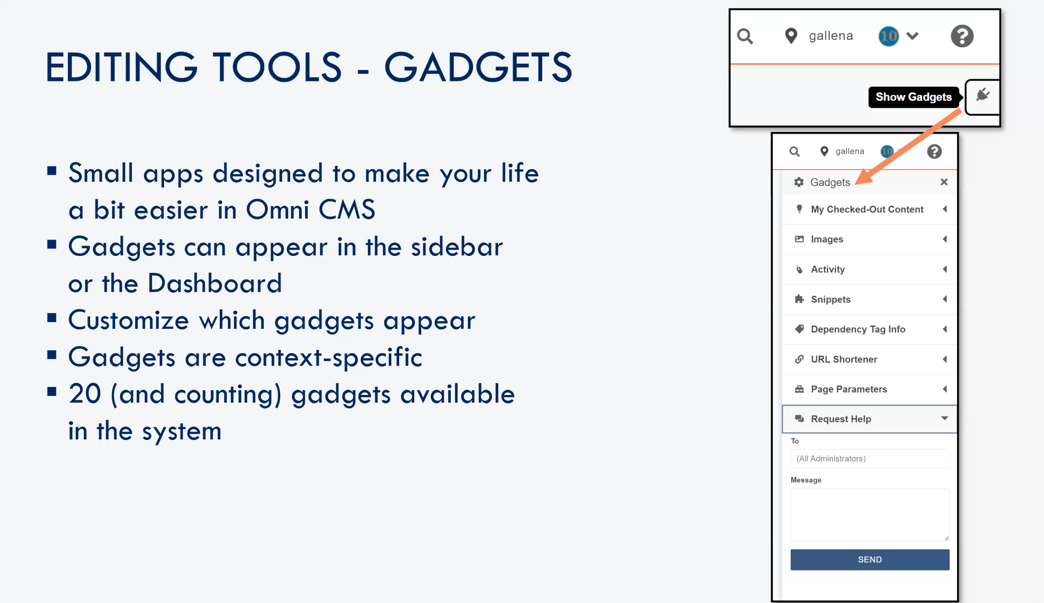

Slide 15
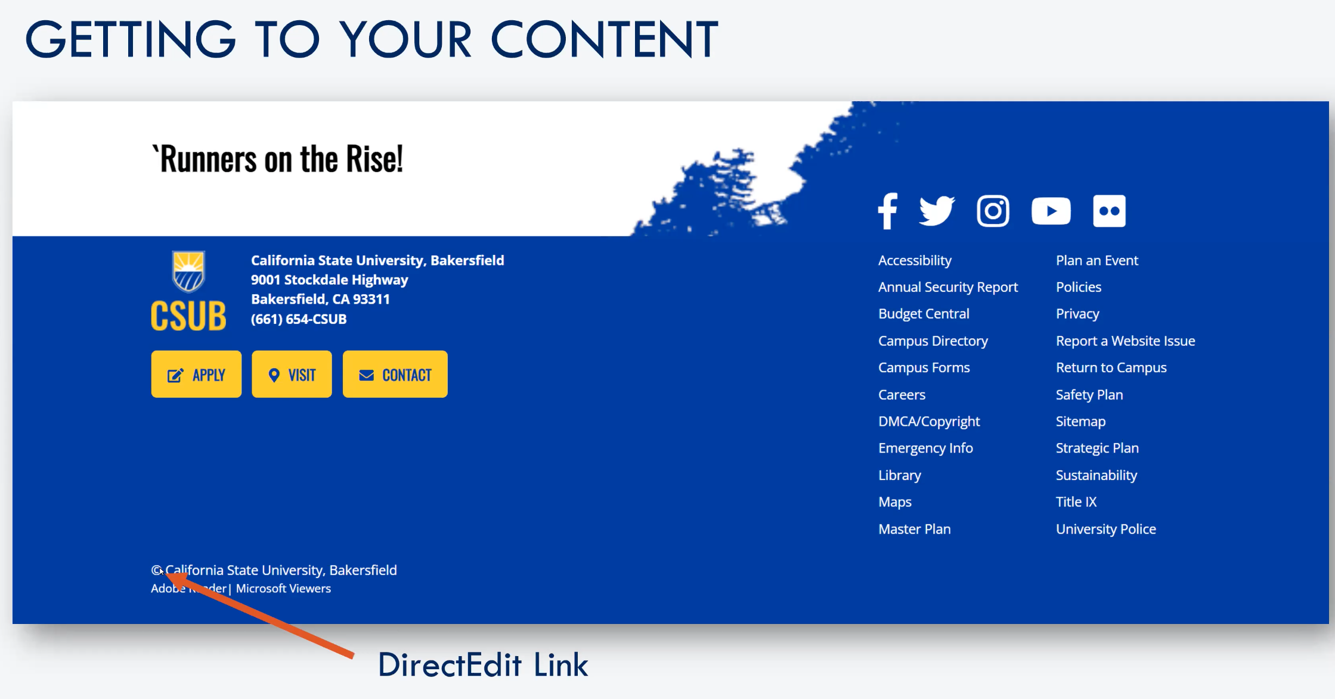

Slide 16
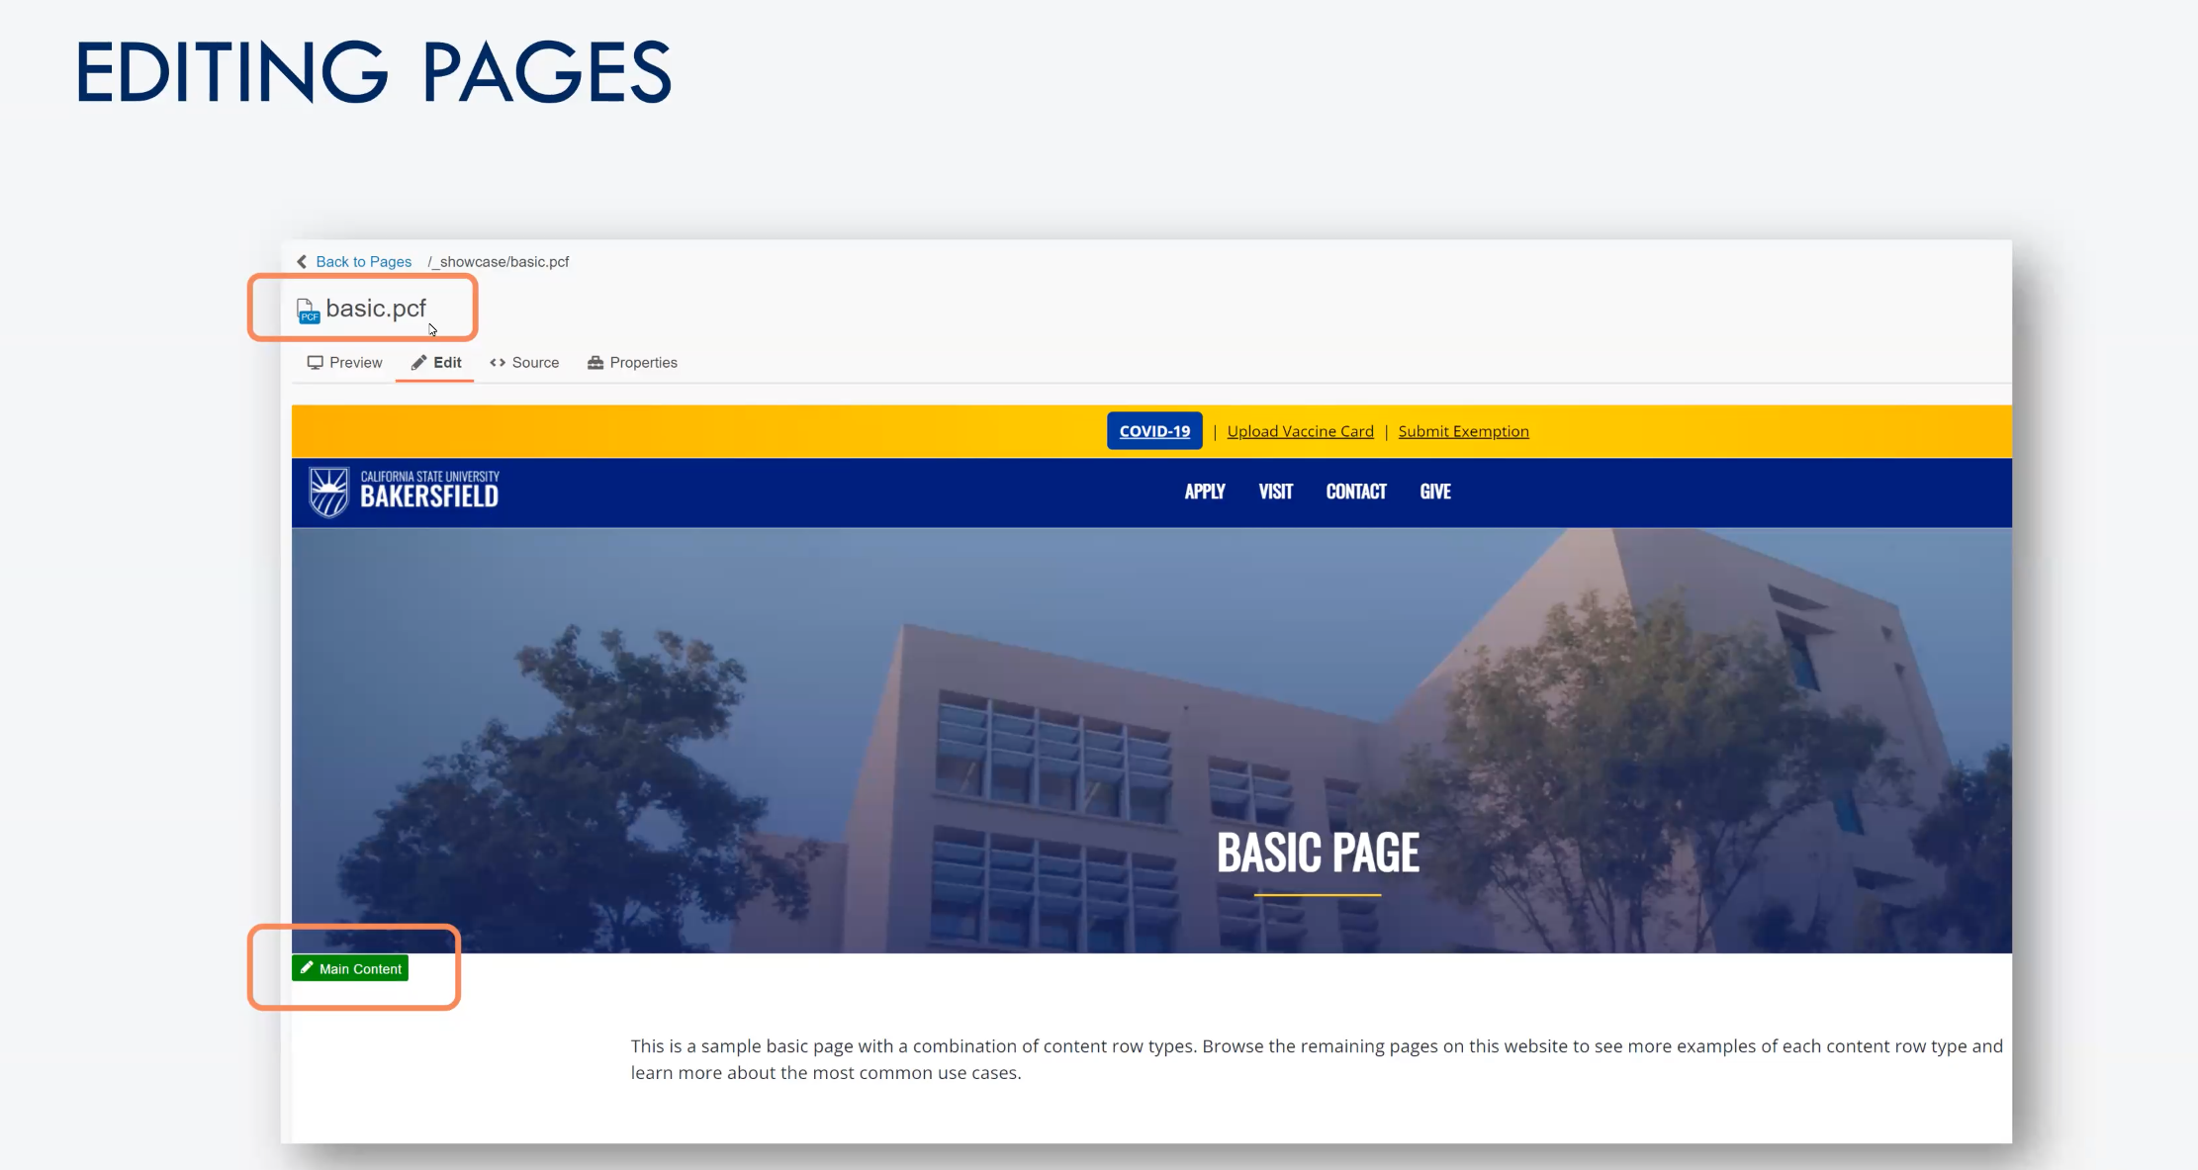

Slide 17
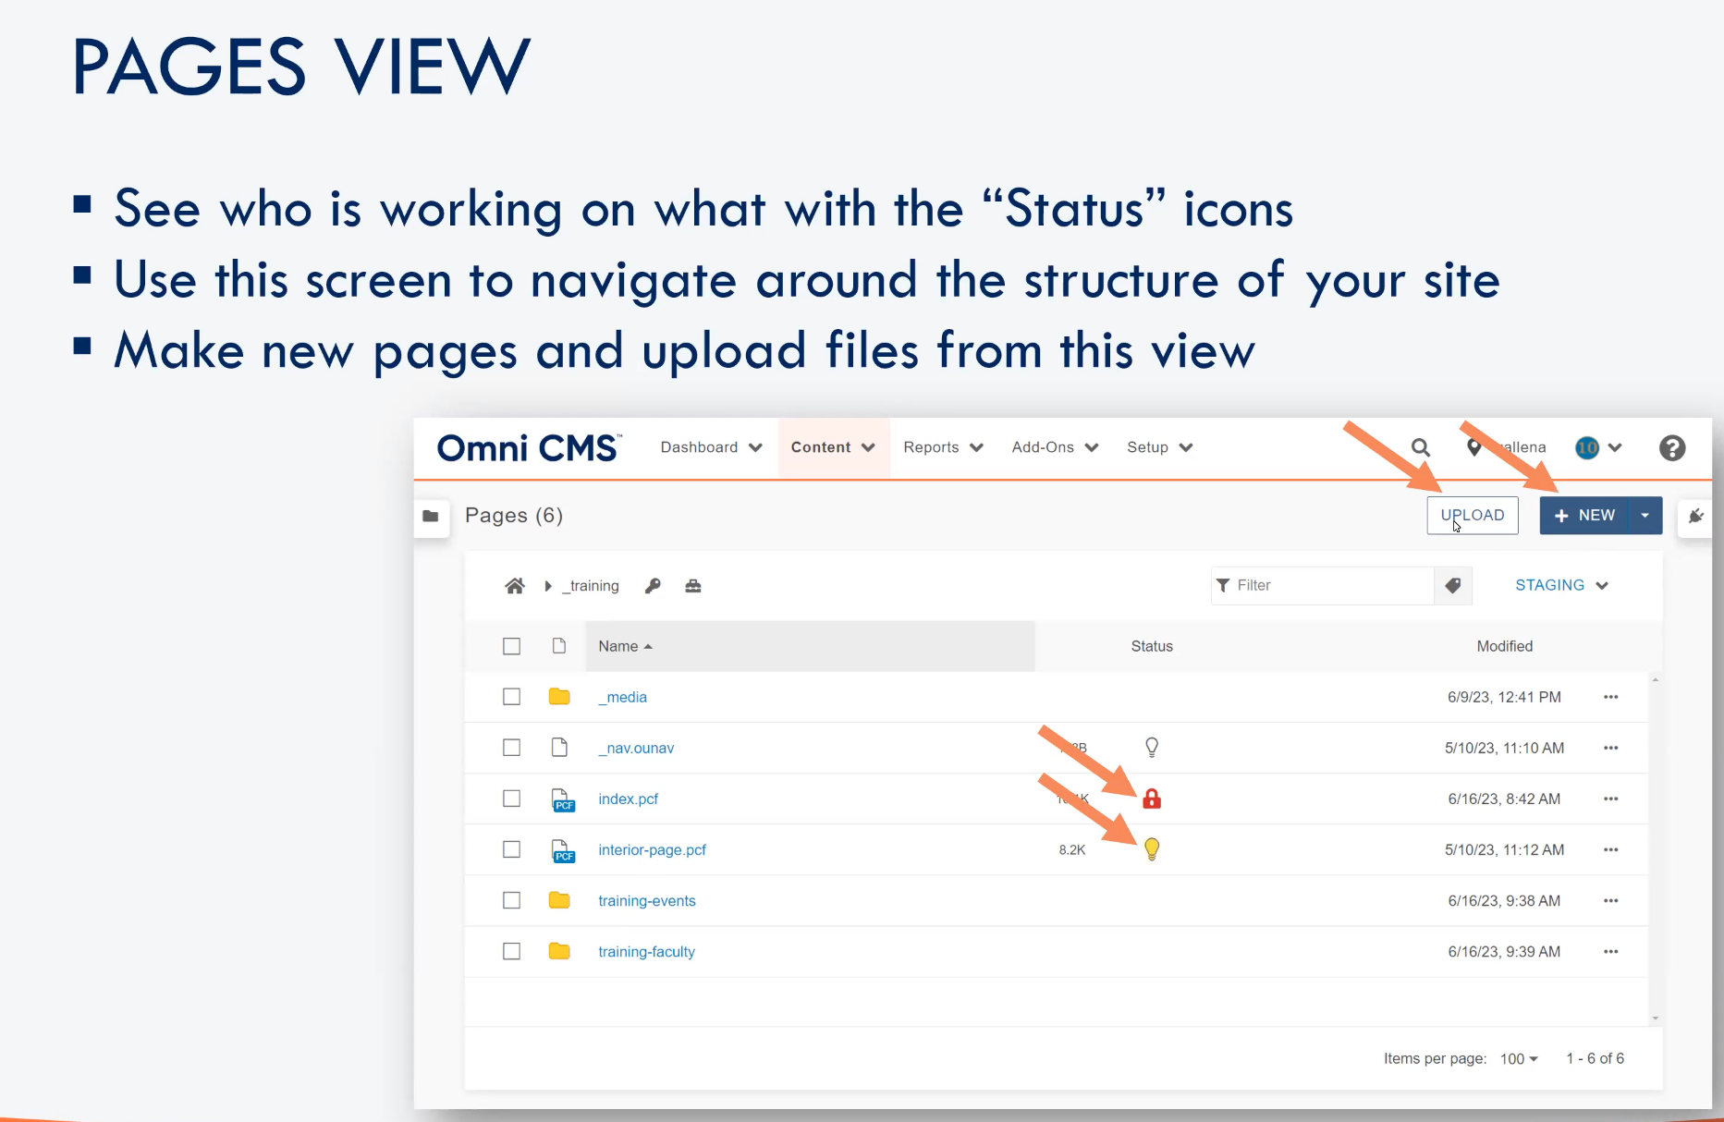

Slide 18
Things to Remember
Travel to your page first, then click DirectEdit link
Only one person can edit a page at a time with the “Check out” system
  Use “My Checked-Out Content” gadget
Dependency Tags are assigned to all internal pages and files
  Dependency manager does not manage external or deleted content
Assets are added to a page where they CANNOT be edited
Snippets are added to a page where they CAN be edited
Components are added to a page where they CAN be edited using form fields
Notes:
This course was designed specifically to answer these four questions

Slide 19
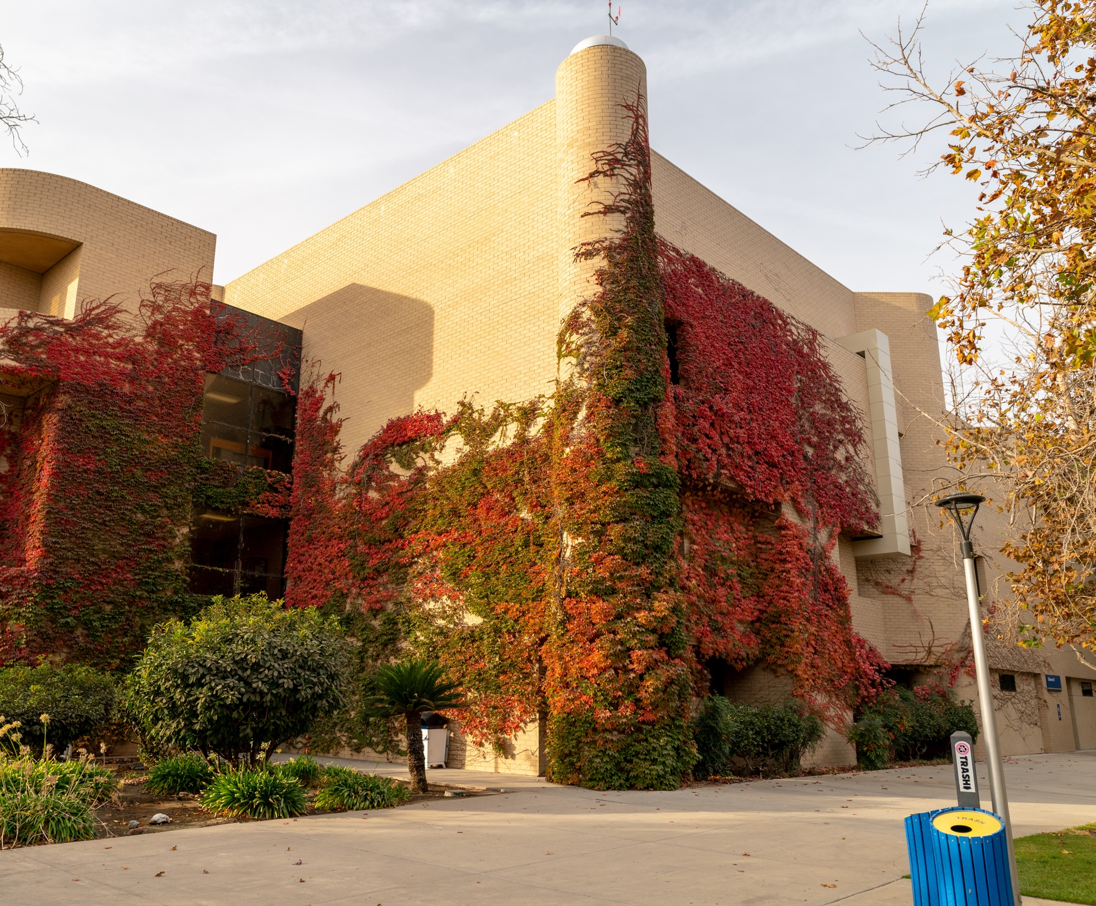

Let’s See it!

Slide 20
THANK YOU FOR ATTENDING!

