Slide 1
Business and Financial Services
Training

Slide 2
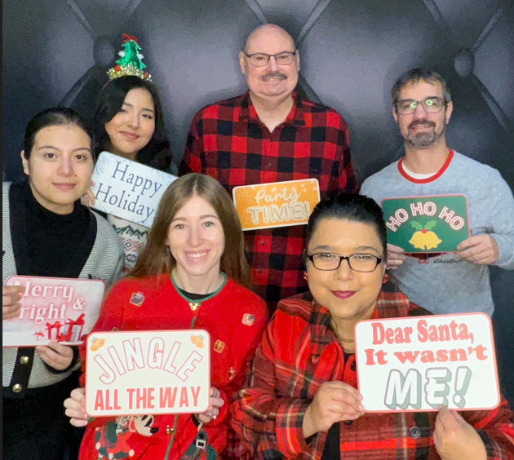
Campus Accounting
Learning Objectives
Importance of Delegation of Authority
Responsibilities of Delegated Approver
Managing and Updating DOA
Overview of DOA Structure
Overview of Chartfield Request Form
Upcoming Changes to DOA
Trust Agreement Purpose
Requirements of Trust Agreements

Slide 3
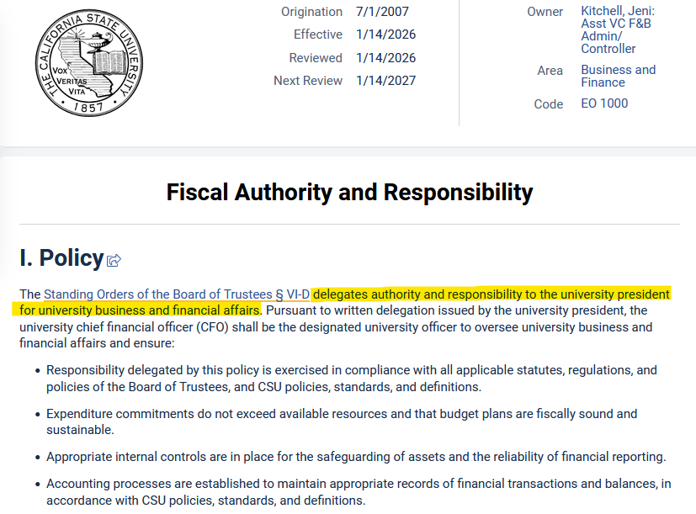
Importance of Delegation of Authority
Pursuant to Executive Order 1000, each campus President is delegated authority and responsibility for all state funds held by campus.
The President, in turn, delegates oversight of campus funds to the Chief Financial Officer and other designated individuals authorized to manage funds and approve expenditures.
To ensure proper tracking of fiscal authority, each campus is required to maintain a record of the President’s delegated authority and all authorized approvers within the Delegation of Authority module in CFS.

Slide 4
Responsibilities of a Delegated Approver
Ensure all transactions are allowable, accurate, properly documented, and in compliance with applicable rules, policies, and guidelines.
Confirm that each expense or purchase is necessary, reasonable, and directly supports campus operations.
Verify that the funding source (fund/dept) is accurate and appropriate for the transaction.
Confirm that sufficient funds are available to cover the expense or purchase. For multi-year commitments, ensure the funding source can support both current and future obligations.
Ensure that expenses charged to sponsored projects or grants comply with all applicable sponsor/grant conditions and regulatory requirements.

Slide 5
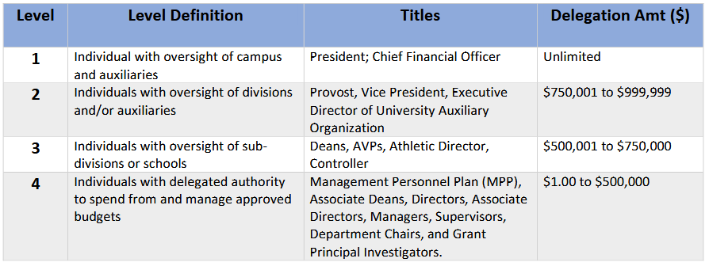
Delegation of Authority Levels
https://www.csub.edu/procurement/_files/CSUB_Financial_DOA_Levels_and_Dollar_Amounts.pdf

Slide 6
CSUB DOA Structure
Managing DOA at CSUB
Chartfield Request Form
  Submitting forms properly
Reviewing DOA data in BOX periodically.
  To request access to BOX, send an email to accounting@csub.edu.
Immediately replace separated approvers
DOA data integrations
  CSUBuy
  Concur (new upcoming changes)
BKCMP
Department-Only DOA (Fund=ALL)
BK001, BKC02, BKCPO, BKCST, BKGRD, MY005
Fund-Only DOA (Dept=ALL)
Remaining M Funds
Remaining BK funds not listed above
All Capital/Construction Funds
BKSTU
Department-Only DOA: SU001
Fund-Only DOA: SU002, SU003
BKASI, BKFDN, BKSPA
Fund-Only DOA (no department numbers)

Slide 7
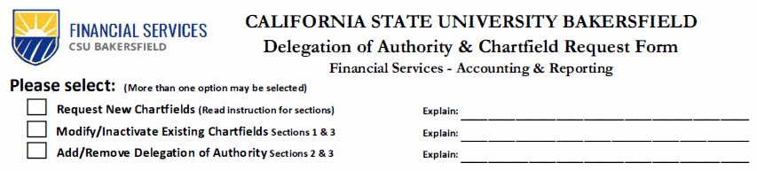
Overview of Chartfield Request Form
Select from 3 Options (multiple options can be selected)
Option 1: Request New Chartfields
  Fund/Dept: complete sections 1 through 3
    New funds require a trust agreement.
  Account, Program, Project, or Class: sections 1 & 3 only.
Option 2: Modify Existing Chartfields
  Includes updating titles or changing effective dates.
  All chartfields: complete sections 1 and 3 only.
Option 2: Inactivate Existing Chartfields
  All chartfields: complete sections 1 and 3 only.
  Fund/Dept: Check box to remove all signers in section 2 only.
Option 3: Add/Remove Delegation of Authority
  Use explanation line to indicate reason for adding or removing signers.

Slide 8
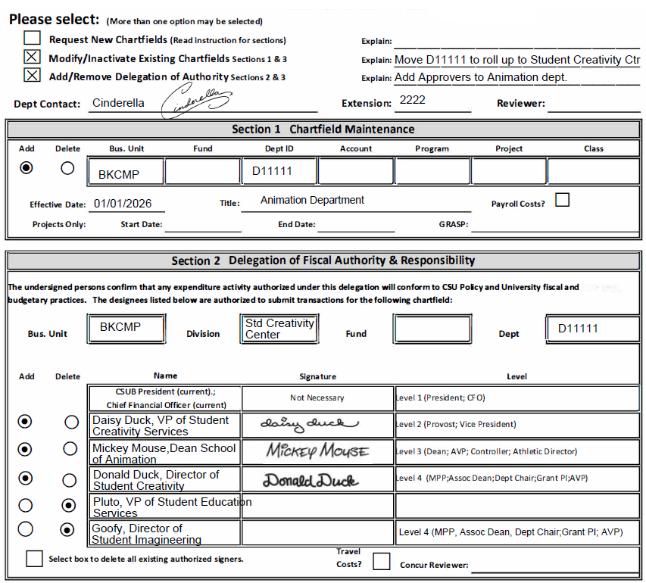
Example Chartfield Request Forms
Request New Chartfields
New miscellaneous trust fund
  Sections 1 through 3
New project code
  Sections 1 and 3 only
Modify Chartfields
Update existing department to new division.
Add/Remove Authorized Signers
Update authorized signers for department roll up change.

Slide 9
Frequently Asked Questions & Common Errors
Frequently Asked Questions
Approver has separated do I need their signature?
How do I delete data or uncheck boxes on form?
Why can’t I type department ID in section 2?
Can an approver be added on multiple levels?
Why can’t I find my fund or department in CSUBuy?
Common Errors
DOA Approver missing CSUBuy DOA Approver Role.
Forgetting to route to correct approvers in Gateway Form Portal.
Forgetting to check Add/Delete buttons in Section 2.

Slide 10
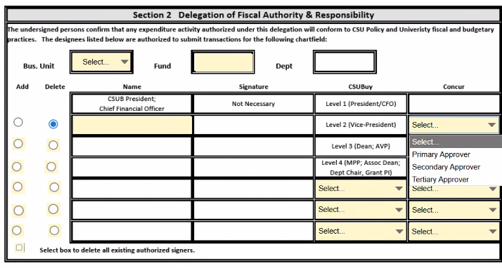
Upcoming DOA Changes
DOA will fully integrate with Concur.
Concur Authority is based on routing order. Levels will not be applicable in Concur.
Three sequential approvers, but only one approver is required.
  Each approver must take action to approve (limit is 10 days).
Departments to review DOA in BOX to determine Concur Approvers starting Thursday, February 26th.

Slide 11
BKCMP Trust Agreement Requirements
The Trust Agreement defines the purpose of the trust fund and affirms that activities conducted within the trust are self-supporting. Each Trust Agreement must be established and maintained in accordance with CSU policies and procedures. The absence of an approved and fully executed Trust Agreement constitutes noncompliance with CSU policy and increases the risk of improper fund management and inappropriate expenditures.
Trust funds that have had no activity within the past two years are subject to review and potential closure.
All trust funds must remain in good standing at all times. Any deficit balance must be promptly reviewed and resolved.

Slide 12
BKCMP Trust Agreement Requirements
Trust agreement must clearly state:
Purpose of all activities within the trust
Source of funds, state methods of collecting funds
Allowable expenditures and restrictions
Reporting requirements
Disposition of funds at termination (this will also determine source of funds for deficit balances)
Responsible individuals for monitoring and managing funds
Approving authority based on Delegation of Authority
Why is this information important:
Ensures trust activities align with CSUB’s mission.
Identifies any potential tax implications.
Verifies expenses comply with CSU policies.
Complies with audit or state requirements.
Ensures trust funds are closed properly and funds handled appropriately.
→Ensures responsibility and accountability.
→Ensures responsibility and accountability.

Slide 13
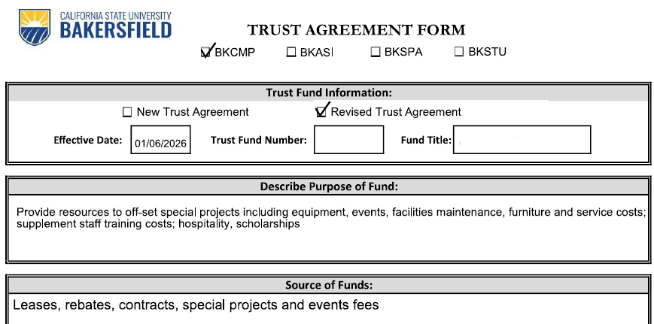
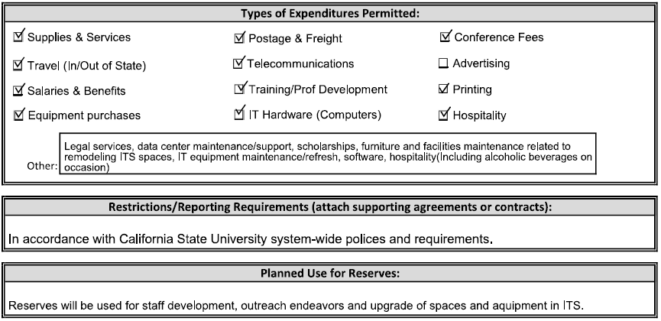
Trust Agreement Example

Slide 14
Campus Accounting
Questions?
Liz Gamez, Director of Accounting and Reporting Services
Phone: (661) 654-6670 Email: lgamez@csub.edu
Lexis Hanssen, Accountant III (SCO Reporting, Chargebacks, IFT Processing)
Phone: (661) 654-2502 Email: lhanssen@csub.edu
Adam Bye, Accountant III (Fixed Assets, Chargebacks, UBIT Tax, Capital Project Reporting)
Phone: (661) 654-2205 Email: abye@csub.edu
Michael Hufnagel, Accountant II (Expenditure Transfers, Chargebacks, Non-Resident Alien Tax Reporting) Phone: (661) 654-2685 Email: mhufnagel@csub.edu
Emily Monterrosas Azamar, Accountant I (Chargebacks, Signature Authority Updates, Runnercard)
Phone: 661-654-6458 Email: emonterrosas-azamar@csub.edu

Slide 15
Q&A

Slide 16
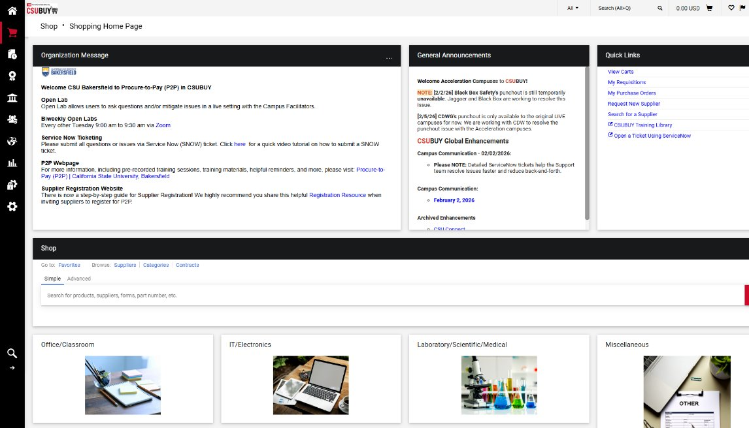
Procurement & Contract Services
CSUBUY
Procure-to-Pay (P2P)

Slide 17
CSUBUY P2P cont.
  Create and submit Requisitions to order goods and services and/or pay invoices.
  Use the correct form type for the purchase.
  Do not use to process payments to CSU employees, retirees or current students.
  Suppliers must complete registration to be active for shopping.
  Verify commodity code is accurate for goods or services.
  Attach quotes, contracts, and invoices related to order.
  3-way match requires receiving, 2-way match requires invoice approval.

Slide 18
Requisition/Purchase Order Processing
Orders for furniture, catering, event rentals, software, on-site services, contractual services must be submitted in CSUBUY Procure-to-Pay for Procurement to process.
Procurement buyer obtains insurance and/or processes contract, if applicable. Purchase Order issued once all required approvals obtained.
Plan ahead and submit 4-6 weeks prior to event or when good/service needed, however, some requests, such as IT software, can take longer.
If supplier is new and not active in P2P, can take 2-4 weeks or longer to process.
High dollar purchases and/or multi-year contracts may require bidding, contact Procurement for determination and next steps.

Slide 19

Unauthorized Purchases
Purchases for goods or services made without an authorized purchase order or contract processed by CSUB Procurement & Contract Services, is a violation of State law and CSU policy.
Such unauthorized purchases can be considered a personal obligation of the individual who made the purchase as opposed to an obligation of the University, requiring reimbursement for the expense.

Slide 20
Contract Signing Authority
Only Authorized officials under delegation can sign contracts on behalf of the Trustees of the CSU or its Auxiliaries.
Campus and ASI: President, CFO, CPO or designee
Foundation (FND): Executive Director Heath Niemeyer
Student-Centered Enterprises (SEI): Executive Director Dwayne Cantrell
Sponsored Programs Administration (SPA): Executive Director Deborah Thien

Slide 21

Contract Processing
Contractual documents that must be reviewed and processed by Procurement:
  Memorandum/Letters of Understanding (MOU/LOU)
  Order Forms or Scopes of Work (SOW)
  Licenses
  Software as a Service (SAAS) or Software Subscriptions
  Placement/Internship/Service Learning
  Leases and Rentals
  Financing
When in doubt, please consult Procurement.

Slide 22
Accessible Technology Initiative (ATI)
The Accessible Technology Initiative (ATI) reflects the CSU’s ongoing commitment to provide access to information resources and technologies to individuals with disabilities. This commitment is articulated in the CSU Policy on Disability Support and Accommodations.
All CSU programs, services, and activities should be accessible to all students, staff, faculty, and the general public. This encompasses all technology products used to deliver academic programs and services, student services, information technology services, and auxiliary programs and services.
  Please visit the ATI Procurement Site for additional information and forms.
  To submit a technology acquisition request: IT Solutions Consulting Request Form

Slide 23

Important to know…
Catering: Use preferred supplier with insurance and food permit on file and registered in P2P, required if vendor is setting up and serving on campus.
CSUB branded Apparel/Promotional items: Order from campus Print Shop as they coordinate with Marketing Team to ensure proper and authorized use of campus trademark logos.
Technology items: Submit for IT review as soon as possible as review can take 3-4 weeks or longer, depending on responsiveness of vendor. Procurement cannot process PO and/or contract until IT has approved.
Building Improvements/Construction: Consult with Facilities for items that require mounting to walls or modifications to buildings such as large equipment, modular walls that go up to ceiling, or require additional network or electrical outlets, etc.

Slide 24
Procurement Policy Updates - Part 1
Revised Competition Thresholds
Goods & Services:
  No competition required: under $100K
  Informal competition: $100K–$250K
  Formal competition: above $250K
Information Technology:
  No competition required: under $100K
  Informal competition: $100K–$1M
  Formal competition: above $1M

Slide 25
Procurement Policy Updates - Part 2
Federal Applicability Clarified (SPA funded transactions)
When federal and CSU requirements both apply, campuses must follow the more restrictive standard, consistent with 2 CFR 200 - Uniform Guidance.
Sole Source Approval Thresholds increased to:
≥ $100K: Campus procurement authority
≥ $250K: VP for Administration/Finance
≥ $1M: Chancellor’s Office review and approval

Slide 26
Distribution Services
Distribution Services, formerly known as Campus Services, consists of the following areas:
Asset Management (Property)
Mail Services
Shipping & Receiving

Slide 27
Roles & Responsibilities in Managing Property
Each Department has the primary responsibility for the custody, care, maintenance, and control of property assigned to their respective area.
The University is responsible for proper recordkeeping, maintenance, and safekeeping of state and federal equipment in its possession. It helps to ensure the university:
In compliance with CSU and State guidelines
In compliance with Federal Guidelines, especially when related to sponsored research
Maintains accurate and timely records
Maximizes use of resources
Has proper stewardship of assets and supplies

Slide 28
Roles & Responsibilities in Managing Property (cont.)
University employees have an obligation to safeguard University property.
This obligation includes:
Using property for University purposes only; not removing property from campus except for official University business.
Using and maintaining property in an appropriate manner.
Returning property to the University prior to separation from the University.
Taking reasonable security precautions to discourage loss, theft, or misuse of property.
Report lost or stolen property immediately.

Slide 29
Department Property Custodian Responsibilities
Maintains current, complete, accurate property records and tracks the assignments of property within the department.
Notifies Asset Management of any changes by completing respective Kuali forms.
Serves as the point of contact for the department regarding asset management, including inventories.

Slide 30
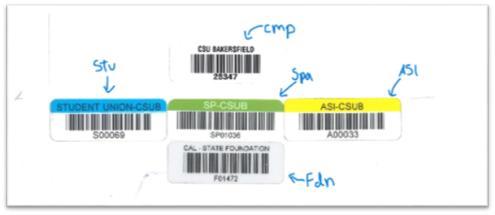
Trackable Property
Capital Equipment
  A unit acquisition cost of $5,000 or greater.
  An estimated life greater than one year.
  Is not permanently attached to or incorporated into campus buildings and grounds.
Non-Capitalized Equipment
  A unit acquisition cost of $2,500 - $4,999.
Sensitive Equipment
  Equipment that is easily subject to theft or loss.
    Laptops
    Computers
    Tablets

Slide 31
Q&A

Slide 32
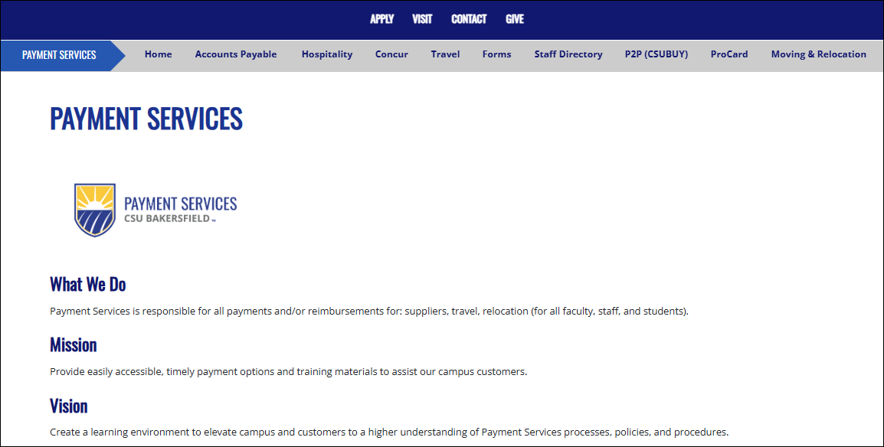
Payment Services
Payment Services Homepage
https://www.csub.edu/paymentservices/
Notes:
ADD Welcome and Introduce, hold questions
If you haven’t visited our website recently, I highly recommend bookmarking it. You can find it at csub.edu/paymentservices.
This is where you’ll find forms, updates, training materials, and helpful resources.

Slide 33
Payment Services Resources
Payment Services Webpage | Resources Available
Home Page | Overview & Contact Information
Accounts Payable | AP Matrix & Information on Petty Cash, Student Payment, and International Wires
Hospitality | Hospitality Policy, Training Videos, Maximum Rates, and Hospitality Matrix
Concur | Concur Login, Travel Updates, Micro Learning Videos, and Quick Resource Guides
Travel | Travel Policy, Quick Resource Guides, and Information on Local Hotels, Rental Vehicles, and Travel Agencies.
Forms | List of all Payment Services Forms
Staff Directory | Current Staff Listing and Contact Information
P2P (CSUBuy) | Hyperlinks to Launch P2P and Marketplace
ProCard | ProCard Handbook and Policy, Training Videos, and US Bank Contact Information
Moving & Relocation | Moving & Relocation Policy, Checklist, and Matrix
Notes:
I want to take a minute to highlight the Payment Services Resources tabs on our website.
‘Quickly run through the table’

Slide 34
Concur Optimization Project
This is a CSU-wide effort to move all CSU campuses and auxiliaries that use CFS onto one shared Concur system for travel and expense management.
The goal is:
Make processes easier to use
Improve consistency across the CSU
Apply policies the same way
If you already use Concur, this will feel familiar, but with new features and improvements.
When the new Concur platform goes live, it will support:
Travel and expense reimbursements
Travel Card and ProCard requests
ProCard reconciliation
Hospitality expenses
Notes:
Let’s talk about the Concur Optimization Project. This is a CSU-wide effort to bring all campuses and auxiliaries using CFS onto one shared Concur system for travel and expense management.
CSU wants to make processes easier to use, improve consistency, and apply policies the same way across campuses.
If you already use Concur, the system will feel familiar, but with improvements and added features.
When the new platform goes live, it will support:
Travel and expense reimbursements
Travel Card and ProCard requests
ProCard reconciliation
And Hospitality expenses

Slide 35
Concur Optimization Project Timeline
February 28 - March 8, 2026 | Concur Blackout Period
March 3, 2026 | Campus Information Session
Delegate Training Sessions | Select the option that works best for you: 03/04 | 10:00–11:00 a.m. 03/05 | 3:00–4:00 p.m.
March 9, 2026 | Travel & Hospitality will officially transition to the optimized Concur platform. ProCard Reconciliation to be rolled out in phases with a pilot group transitioning in March.
New User Training Sessions | Select the option that works best for you: 03/10 | 10:00–11:30 a.m. 03/11 | 3:00–4:30 p.m.
April 1, 2026 | Final date for paper travel claims (exception: SPA)
Current User Training Sessions | Select the option that works best for you: 03/03 | 1:30–2:30 p.m. Registration Link 03/05 | 11:00–12:00 p.m. Registration Link 03/10 | 10:00–11:00 a.m. Registration Link 03/11 | 10:00–11:00 am Registration Link
Summer-Fall 2026 | Further ProCard Expansion
Notes:
This slide outlines the implementation timeline.
Pay attention to key transition dates. As we move closer, we’ll continue communicating what actions you need to take and when.

Slide 36
Concur Optimization Project Resources
Webpages:
CSU Webpage: Concur Optimization Project
CSUB Webpage: Concur Travel & Expense (CTE) | California State University, Bakersfield
Open Labs (twice weekly beginning March 9th):
Mondays, 3:00–4:00 p.m. : Monday Open Lab Zoom Link
Thursdays, 11:00 a.m.–12:00 p.m. : Thursday Open Lab Zoom Link
For questions, please contact our centralized support email at concur@csub.edu.
Notes:
We have several resources available:
The CSU Concur Optimization webpage
The CSUB Concur Travel & Expense webpage
Open Labs twice a week starting March 9
Mondays from 3–4 p.m.
Thursdays from 11–12 p.m.
These are great drop-in sessions if you want hands-on help.
And of course, you can always email concur@csub.edu with questions.
Now I will let Tina discuss Hospitality.

Slide 37
Hospitality
What is considered a Hospitality Expense?
Hospitality expenses must be directly related to, or associated with, the active conduct of official CSU business. When an employee acts as an official host, the occasion must, in the best judgment of the approving authority, serve a clear CSU business purpose, with no personal benefit derived by the official host or other employees.
Hospitality is the provision of meals (catered or restaurant) or light refreshments (beverages, hors d’oeuvres, pastries, cookies, etc.), entertainment services, promotional materials, awards, and service recognition. Hospitality includes expenses for activities that promote the university to the public, usually with the expectation of benefits accruing directly or indirectly to the university.
Notes:
Hospitality expenses must be directly related to official CSU business and there can’t be personal benefit involved.
Hospitality includes:
Meals or catering
Light refreshments
Entertainment services
Promotional materials
Awards
Service recognition
A good rule of thumb: If the event promotes the university or supports official business, it may be allowed but documentation and justification are key.

Slide 38
How to Pay an Invoice
Direct Pay:
Adobe Sign - Can use this form when the supplier is awaiting P2P approval and there is a time constraint.
  Payments to individuals and companies that should not be on a PO
  Attorney Fees (non-contractual) and settlements (requires HR or Provost pre-approval)
  Refunds
  Taxes
  Older invoices/requests that contain confidential information and do not require a contract.
  Note: Employee Reimbursements will be routed through Concur going forward.
Notes:
There are a few ways to pay an invoice.
Direct Pay is used in specific situations like:
Attorney fees or settlements (with required pre-approval)
Refunds
Taxes
Older invoices with confidential information
Suppliers waiting for P2P approval when timing is critical
Important reminder: Employee reimbursements will begin to go through Concur. You will see the option available in Concur as of March 9th. Please continue to utilize the DP form until you have been trained in the Concur system. We will stop accepting DP forms on employee reimbursement as of April 1st.

Slide 39
How to Pay an Invoice
P2P/CSU Buy: Direct Pay
Can be used for:
  Attorney Fees
  Freight / Postage / Shipping
  Legal Settlements
  Local & Federal Government Payments
  Medical Service Payments
  Memberships
  Official / Referee payment
  Permit License (non-IT)
  Royalty Payment
  Student Union Return of Surplus
  Subscription/Publication (non-IT)
  Utilities
  P2P/CSU Buy: PO’s
  0
  This system should be utilized for all POs – unless CFS has multi-year or confidential contracts on-going.
  Requestor receives an Invoice and attaches it to the PO as a comment in P2P.
  Invoices sent directly to Payment Services (accounts_payable@csub.edu) by the supplier will be attached to the PO
  Any PO with services will require a 2-way match by the requestor
  POs for goods will be received by Distribution Services
Notes:
P2P, also known as CSU Buy, should be used for most purchase orders unless there are multi-year or confidential contracts already established in CFS.
Now let’s clarify when Direct Pay can be used within P2P / CSU Buy.
Direct Pay is intended for specific types of payments that typically do not require a traditional Purchase Order process.
It can be used for:
Attorney fees
Legal settlements
Local and federal government payments
Medical service payments
Memberships
Official or referee payments
Permit licenses that are non-IT
Royalty payments
Student Union return of surplus
Subscriptions or publications that are non-IT
Utilities
Freight, postage, and shipping
If you notice a theme, many of these are payments that are either regulated, government-related, service-based, or recurring in nature.
P2P/CSU Buy: PO’s
Here’s how it works:
The requestor attaches the invoice to the PO in P2P
If the supplier sends it to Payment Services, we attach it
Service POs require a 2-way match by the requestor
Goods are received through Distribution Services
When in doubt, ask yourself: Should this have a PO? In most cases, the answer is yes.

Slide 40
How to Pay an Invoice
Petty Cash:
Reimbursement requests for <$50.00 must be submitted to the Cashier's Office on a Petty Cash Form.
Student Payments:
All student payments must go through the Financial Aid Office, unless:
  A reimbursement of an expense
  The student invoices CSUB as part of a business they own.
  The payment meets the Internal Revenue Service (IRS) definition of de minimum ($100 or less).
  To receive payments, students must complete the Vendor Data Record 204 Form
Notes:
Petty Cash is only for reimbursements under $50 and must go through the Cashier’s Office.
For student payments, they must go through Financial Aid unless:
It’s a reimbursement
The student invoices CSUB through their own business
The payment qualifies as de minimis — meaning $100 or less
Students must complete the Vendor Data Record 204 Form before receiving payment.
Now, Melissa will talk about ProCard.

Slide 41
ProCard Forms
Form | Use When…
ProCard Application | Requesting to obtain a CSUB issued ProCard
ProCard Revision Form | To make permanent changes to Cardholder’s ProCard information
ProCard Temporary Limit Increase Request Form | Request a temporary increase to single and/or monthly transaction limits
ProCard Reconciliation and Approval Form | Reconciling and submitting monthly statements
ProCard Software Waiver Form | Making software purchases on ProCard, as it’s prohibited and requires approval from Procurement
ProCard Printshop Waiver Form | Making promotional purchases from outside vendors
Note: More information will be coming on how these forms will change as a result of the Concur Optimization Project.
Notes:
Here is a listing of all of our ProCard forms that we utilize. (Briefly go through the table)
ProCard forms will be changing as part of the Concur Optimization Project. More information is coming soon, so stay tuned.

Slide 42
ProCard Reminders
Software Transactions
  Software is prohibited on ProCard and requires special approval from Procurement.
  Cardholders bypassing IT and/or Procurement process.
  All software transactions on a ProCard must require a ProCard Software Waiver Form attached, regardless if previously approved by Procurement.
Lost Receipt Forms
  Intended only to document when the original receipt is unavailable after making effort to obtain it.
  Annual Limit – Cardholder may submit up to 4 Lost Receipt Forms per fiscal year. Any additional forms will be routed to Controller’s office for further review and approval by ProCard Technician.
  Lost Receipt Forms not allowable for rental, airfare, or hotel expenses under any circumstances.
Notes:
We want to go over a few reminders for our ProCard holders/reconcilers.
Software is prohibited on the ProCard unless special approval has been obtained from Procurement. That means cardholders should not be purchasing software directly and bypassing IT or Procurement processes.
Even if software has been approved in the past, every single software transaction placed on a ProCard must include a ProCard Software Waiver Form attached. No exceptions.
The reason for this is bigger than just payment processing. Software purchases involve:
Data security
Licensing compliance
Accessibility standards
Contract terms
IT and Procurement are involved to protect the university. So, if you’re ever unsure whether something qualifies as software, pause and ask before swiping the card.
Now let’s talk about Lost Receipt Forms.
These are intended to be used only when you’ve made every reasonable effort to obtain a duplicate receipt and truly cannot. They are not a convenience form, they’re a last resort.
There is an annual limit of four Lost Receipt Forms per fiscal year per cardholder.
If more than four are submitted, the additional forms are routed to the Controller’s Office for further review and approval by the ProCard Technician.
Lost Receipt Forms are never allowable for:
Airfare
Hotel
Rental car expenses
Under any circumstances.
Bottom line is to keep your receipts. We accept pictures of receipts, so utilize all your resources. Use the form only when absolutely necessary, and if you’re trending toward that fourth form, that’s a good time to reassess your process.

Slide 43
ProCard Reminders
Regalia for Faculty
Using Stateside Funds
  Purchase of Regalia is prohibited as they are considered personal purchases.
  Regalia can be rented and require a detailed receipt indicating the rental.
Using Auxiliary Funds
  Purchase of Regalia is allowed on Auxiliary funds.
  If the Regalia purchase is intended for awards or other purpose benefiting students, include a detailed receipt and hospitality form.
Notes:
Let’s talk about regalia, because this is one of those areas where the funding source really matters.
When using Stateside funds, the purchase of regalia for faculty is prohibited. That’s because regalia is considered a personal purchase, even if it’s being used for commencement or official university events. However, regalia can be rented using Stateside funds.
If you’re renting, you must provide a detailed receipt that clearly indicates it was a rental, not a purchase. If the receipt does not state that it is a rental, please provide documented confirmation from the vendor that it is.
Now, if you’re using Auxiliary funds, the rules are different.
Purchase of regalia is allowed on Auxiliary funds.
However, documentation still matters.
If the regalia purchase is intended for awards or another purpose that benefits students, you’ll need:
A detailed receipt
A completed Hospitality form
So before moving forward with any regalia expense, pause and ask:
What fund source am I using?
Is this a purchase or a rental?
Does this benefit students and require additional documentation?
That quick check upfront prevents delays later.

Slide 44
ProCard Reminders
Awards
Gift cards are to ONLY be purchased through ProCard and require a Hospitality Justification Form and Gift Acknowledgment Form.
Tangible awards require a Hospitality Justification Form. Tangible awards are any awards for student graduates, years of service, awards for campus events, etc.
Awards for Campus Programming (project number on chartfield) do not need the Hospitality Justification Form.
Notes:
Let’s talk about awards, because this is an area where documentation also matters.
First, gift cards.
Gift cards must ONLY be purchased using a ProCard. They should never be purchased personally and reimbursed.
In addition to the purchase, you must include:
A Hospitality Justification Form
A Gift Acknowledgment Form
That acknowledgment form is critical because gift cards are considered cash equivalents. We need documentation showing who received it and why.
If you’re thinking about purchasing gift cards, pause and make sure you have a plan for tracking and documentation before completing the transaction. If purchasing on behalf of staff or faculty, be sure to collaborate with the cardholder to ensure someone is tracking and documenting this purchase.
Now, tangible awards — meaning physical items.
This includes things like:
Student graduate awards
Years of service awards
Prizes for campus events
Recognition items

Slide 45
ProCard Reminders
Hospitality Forms
Be sure to edit blanket Hospitality Forms when used throughout a time period noted on the event date.
Stay within the approved amounts.
DOA approvers cannot approve their own forms. Approvers cannot be a guest benefiting from the event. Please route to your next level of approval unless they are a VP.
Notes:
All tangible awards require a Hospitality Justification Form.
The purpose of that form is to clearly document the business justification and ensure the expense aligns with policy.
There is one exception.
If the award is for Campus Programming and tied to a project number on the chartfield, the Hospitality Justification Form is not required.
Now a few quick but important reminders about Hospitality Forms in general.
If you’re using a blanket Hospitality Form for events that occur over a period of time, make sure you edit it appropriately to reflect the correct dates and details. Don’t just reuse it without updating it.
Stay within the approved amounts.
And very important:
DOA approvers cannot approve their own forms.
Approvers cannot be a guest benefiting from the event.
If that situation comes up, route it to your next level of approval — unless that person is a Vice President.

Slide 46
ProCard Reminders
Shipping
All transactions on a CSUB issued card must be shipped and billed to campus, not personal addresses.
Helpful Tips
Call US Bank for balance inquiry when preparing for a CSUB event or CSUB business related trips.
ProCard billing cycle dates set as reminders or printed and put somewhere visible to reference.
Notes:
Let’s cover a couple of quick but important reminders.
All transactions made on a CSUB-issued card must be shipped and billed to campus — not to personal addresses.
That includes home addresses. Even if it feels more convenient, shipments cannot go to a personal residence.
University funds must follow university controls, and shipping to campus ensures proper receipt, tracking, and accountability.
If something absolutely cannot be shipped to campus, that’s a moment to check with Procurement or Payment Services before completing the transaction. If your supervisor has approved an exception to this, we will need to see an emailed approval noting the exception when your ProCard Reconciliation is submitted. Please note, this should not be a frequent occurrence.
Now a few practical tips that will save you stress.
If you’re preparing for a CSUB event or traveling for business, call US Bank ahead of time to confirm your available balance. There’s nothing worse than being mid-transaction and realizing you’ve hit your limit.
Now, we will turn it over to Feli.
Also, make sure you know your ProCard billing cycle dates. Set calendar reminders or print the schedule and keep it somewhere visible. Staying ahead of those deadlines prevents late reconciliations and compliance issues.
Small habits like checking balances and tracking billing cycles make a big difference.

Slide 47
Travel Reminders
  Exceptions for expenses that are typically non-reimbursable and arise because of special or unusual circumstances must be authorized, approved, and documented by the appropriate approving authority. (Usually the Vice President)
  No meals or drinks will be reimbursed for travel less than 24 hours without an overnight stay.
  Travel begins 25 miles from campus. No expenses related to travel will be paid within 25 miles of campus. (hotel, M&IE, per diem, etc.)
  An overnight stay is required for travel reimbursement except when requesting mileage.
  University travelers should not pay for expenses on behalf of others (faculty, staff, etc.) except group travel (faculty or coaches traveling with students).
  Always remember to attach comparisons when personal days or expenses are involved.
Notes:
Now let’s walk through some important travel reminders.
If you’re requesting reimbursement for something that is typically non-reimbursable, and it’s due to special or unusual circumstances, it must be:
Authorized
Approved
Documented by the appropriate approving authority — which is usually the Vice President.
If it’s outside standard policy, it needs higher-level visibility and documentation. When in doubt, get that approval in advance.
No meals or drinks will be reimbursed for travel that is less than 24 hours and does not include an overnight stay.
So, if you’re attending a one-day conference and returning the same day, meal reimbursement would not apply.
Additionally, travel officially begins 25 miles from campus.
No travel-related expenses will be paid within 25 miles of campus — including hotel, meals and incidental expenses, or per diem.
An overnight stay is required for travel reimbursement — except when you are requesting mileage only.
So if you’re driving somewhere beyond 25 miles but not staying overnight, you may claim mileage, but not lodging or meals.
University travelers should not pay for expenses on behalf of others — whether that’s faculty or staff.
The exception is group travel, such as faculty or coaches traveling with students.
Outside of that, each traveler should submit their own expenses. This protects everyone and keeps reporting clean.
If personal days are added to a business trip, you must attach cost comparisons.
For example, if you extend a trip over a weekend for personal reasons, you need documentation showing what the airfare or lodging would have cost for business-only dates.
The university can only reimburse the business portion — so those comparisons are essential.
If you’re ever unsure whether something qualifies, it’s always easier to ask before booking than to try to justify it afterward.

Slide 48
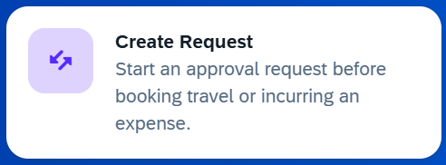
Travel Requests
All travel must be pre-approved by the appropriate approving authority in one of the following ways:
  Charge Request (for Uniglobe or car rentals if not using Concur)
  Concur Request (provide the request number to Uniglobe or the car rental company)
Please Note: Travel Authorization Request Form (TARF) will no longer be utilized for travel occurring after April 1, 2026. The Concur Travel Request replaces this.
Notes:
Let’s talk about pre-approval —
All travel must be pre-approved by the appropriate approving authority before any expenses are incurred.
There are two approved ways to do this:
First, a Charge Request — this is used for Uniglobe bookings or car rentals if you are not using Concur.
Second, a Concur Request — and if you’re booking through Uniglobe or a car rental company, you must provide them with the approved request number.
If there is no pre-approval on file, reimbursement may be delayed or denied. So the safest approach is simple: get approval first, book second.
Very important update:
The Travel Authorization Request Form, or TARF, will no longer be used for travel occurring after April 1, 2026.
The Concur Travel Request replaces it entirely.
So going forward, Concur is the system of record for travel approvals once live on March 9th.
If you’re unsure which method applies to your situation, check before booking. Pre-approval protects you, your department, and the university.

Slide 49
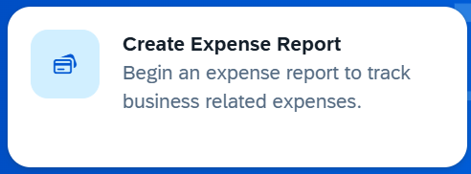
Travel Expense Claims
A travel expense claim must be submitted whether or not any money is owed to the traveler.
The total amount of all expenses related to a particular trip must be accounted for when submitting a travel expense claim, even if the university paid some of them.
Best practice is for travel expense claims to be submitted within 30 days of the end of travel.
Travel expense claims submitted more than 60 days after the end of travel require the approval of the applicable Vice President or their designee and may be subject to tax. Please leave a comment noting the reason it is late if you must submit after the 60 days.
Notes:
Now let’s talk about travel expense claims
First, a travel expense claim must be submitted whether or not any money is owed to the traveler.
When submitting a claim, you must account for the total cost of the trip — even if the university prepaid some of the expenses.
For example, if airfare was charged through Uniglobe or on a university card, it still needs to be included in the claim.
The claim should reflect the full financial picture of the trip.
Best practice is to submit your travel expense claim within 30 days of returning from travel. That keeps everything clean, timely, and compliant.
If a claim is submitted more than 60 days after the end of travel, it requires approval from the applicable Vice President or their designee.
It may also be subject to tax implications.
If you absolutely must submit after 60 days, you need to leave a comment explaining why it’s late.
The easiest way to avoid extra approvals and potential tax issues is to submit early.

Slide 50
Travel Receipts
Mileage: When claiming mileage driven in a personal vehicle, a Google Map must show the route and mileage from the departure point to the trip’s destination. Any substantial deviation from the distance shown in a standard highway mileage guide must be explained.
The departure point should be the employee’s usual work location or home; whichever is closer to the destination. The address of CSUB to be used for mileage is 9001 Stockdale Highway, Bakersfield, CA
Receipts are always required for airfare, hotels, and rental cars.
Other Expenses: A receipt is required for all expenses of $75.00 and over.
It is the traveler’s responsibility to get a detailed receipt for expenses. If the traveler has tried but all measures to obtain a duplicate receipt have been exhausted, a Lost Receipt form must be completed, signed by the traveler and the department approver and attached to the claim.
Notes:
Let’s finish with documentation requirements — because this is where claims often get delayed.
If you’re claiming mileage in a personal vehicle, you must attach a Google Map that shows:
The full route
The mileage
From the departure point to the destination
If your claimed mileage is significantly different from what a standard highway mileage guide shows, you need to explain why.
Now, the departure point should be either:
Your usual work location or Your home. Whichever is closer to the destination.
And when using CSUB as the reference address for mileage, use:
9001 Stockdale Highway, Bakersfield, CA.
Detailed receipts are always required for:
Airfare
Hotels
Rental cars
No exceptions.
For other expenses, a detailed receipt is required for anything $75 or more.
Even if it’s under $75, it’s still best practice to keep documentation.
It is the traveler’s responsibility to obtain detailed receipts.
If you’ve made every effort to obtain a duplicate receipt and truly cannot, then a Lost Receipt Form must be completed.
That form must be:
Signed by the traveler
Signed by the department approver
Attached to the claim
Lost Receipt Forms are not meant to replace good recordkeeping — they’re a last resort.

Slide 51
Q&A

Slide 52
Student Financial Services – Cash Handling Locations
All locations bust be pre-approved by the Chief Accounting Officer to collect any payments. (Forms below)
All cash handling locations must have 2nd person to verify deposits.
Annual completion, unless departmental changes of authorized cash handlers occurs, then the location must submit an updated form.
Background Checks (CSU Policy ICSUAM 06201.00-Sensitive Positions and Cash Handling)
Regular review and reconciliation of cash receipt records to the GL. This ensures accuracy for all transactions.
    Request to Establish/ Maintain Cash Handling Location Request Form
    Cash Handling Annual Review Questionnaire Risk Assessment Form

Slide 53
Student Financial Services – Cash Handling Training
Cash Handling Training is required for all cash handlers.
Cash Handling Training must be renewed annually in CSULearn.
Training expires every year on December 31st for all employees, regardless of completion date.
It is recommended to renew your training in January to allow the maximum time before the next expiration.
Once your training has been completed, the Cash Handling Annual Certification Form will need to be filled out and sent for signature to the Cashier’s Office via email or adobe.

Slide 54
Student Financial Services – Off-Campus Billing
Add your text or graphic content here
Background
Billing Request Form
Invoice Example
Payments
Reconciliation

Slide 55
Background
Add your text or graphic content here
Objective: Billing Request Form is the official process to request invoices.
When: Off campus customer needs to pay CSUB for an event or service.
Contacts: accounts_receivable@csub.edu or 661-654-3975

Slide 56
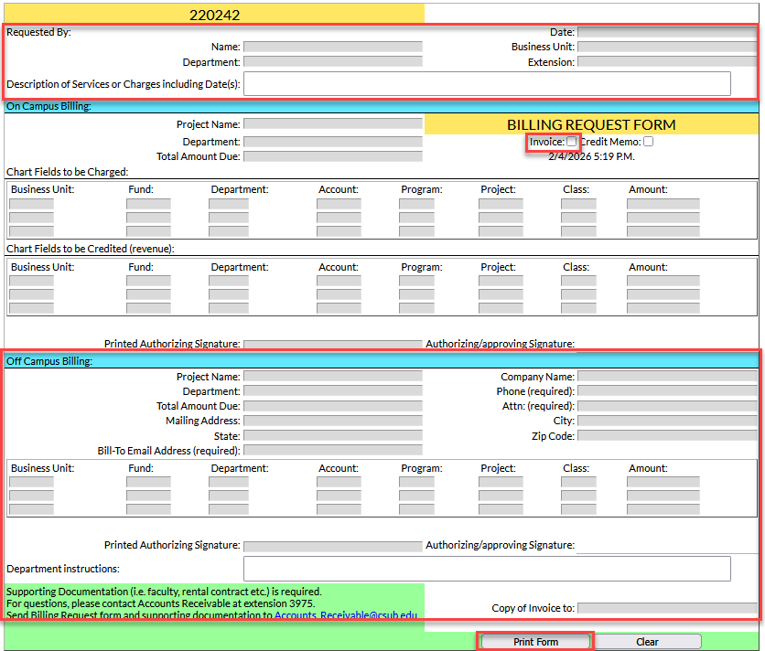
Billing Request Form (BRF)
Location: Campus Forms> Billing Request Form
Checklist
Requestor Information
Description of Services
Customer Information
Chart fields
Authorizing Signature
Copy of Invoice to
Print & Save
Email Form
Add your text or graphic content here

Slide 57
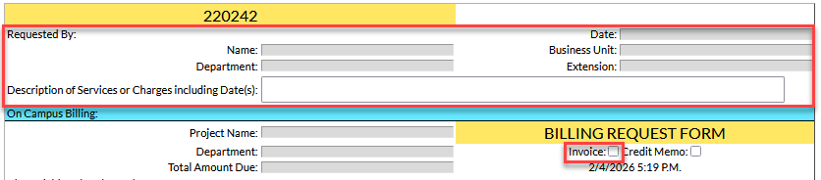
Requestor Information & Services
Add your text or graphic content here

Slide 58
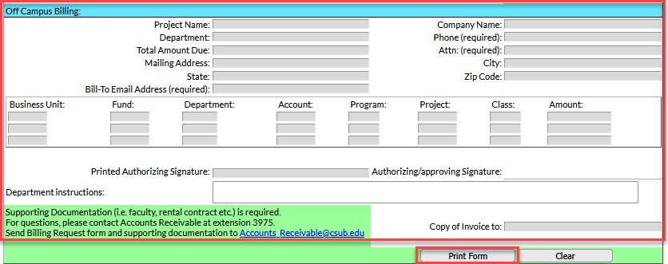
Off Campus Billing Section
Add your text or graphic content here

Slide 59
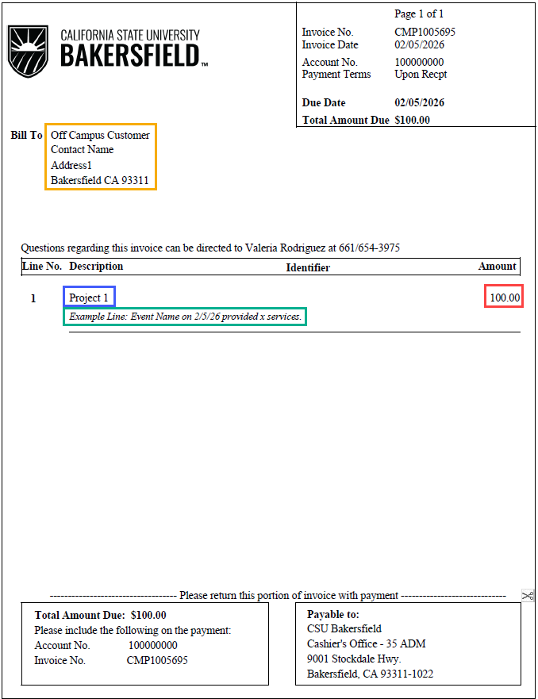
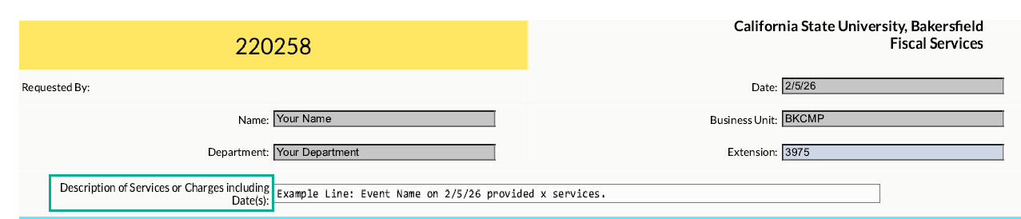
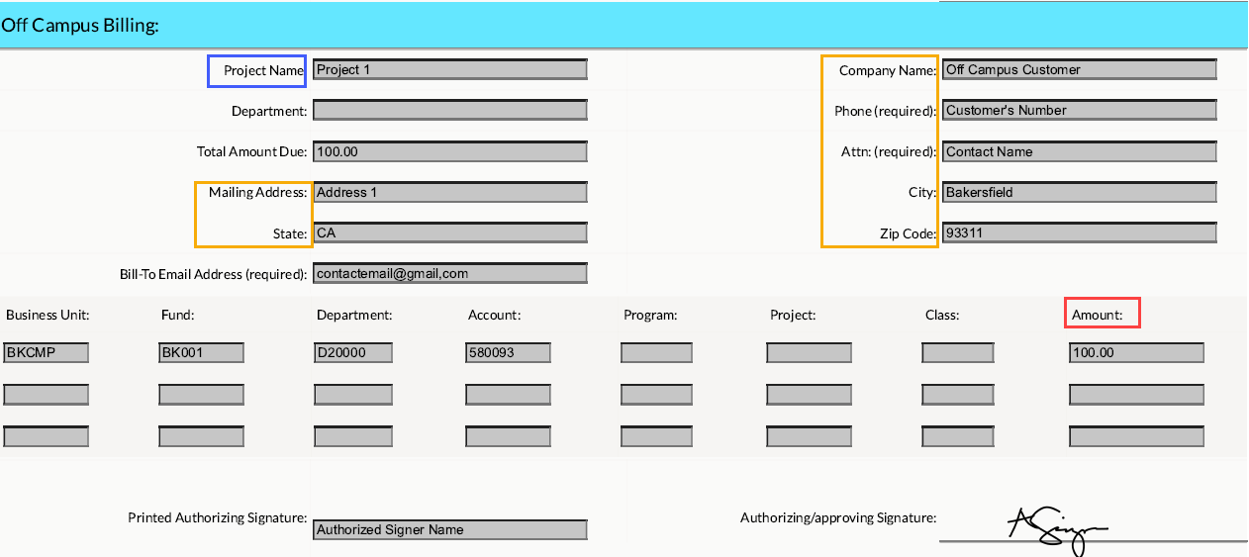
Invoice Example

Slide 60
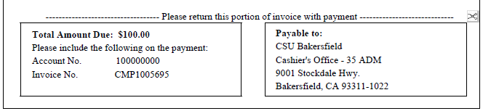
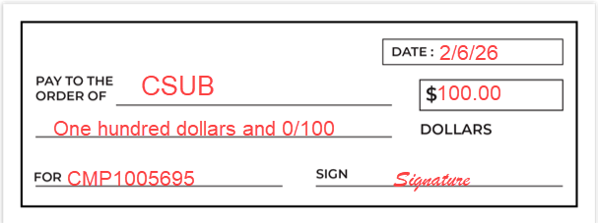
Payments
Cash, Check, Money Orders
Payable to CSUB
Processed by Cashier’s Office
Invoice number required to process

Slide 61
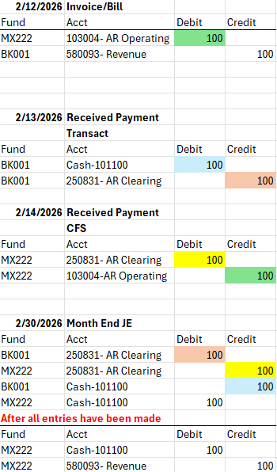
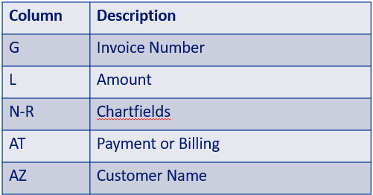
Reconciliation
Payments post to 250831
Monthly journal entry
Data Warehouse Report: Actuals Transactions

Slide 62
Process Summary
Submit BRF
Invoice Created
Payment Received
SFS Monthly Journal Entry
Review in Data Warehouse

Slide 63
Q&A

Slide 64
Foundation - Endowments
What is an endowment?
  Permanent investment fund built from donations
  Principal kept intact
  Investment earnings fund designated purpose
Endowment principal (E0) vs. spend fund (SE/PE)
  E0 designates the principal/permanent portion of the endowment
  SE/PE designates the amount that is allowed to be spent
  SE for scholarship endowments and PE for programming endowments
Notes:
Hi everyone, for those of you who don’t know me, my name is Jassica Gauna. I am the Director of Budgeting and Accounting for University Advancement, Office of the President, and Business Partners.
Today I’m going to cover a couple topics related to the Foundation that can sometimes be confusing: Endowments and Fund Balances.
Please feel free to ask any questions as I cover each topic, and I will also save some time at the end for Q&A.
I want to start by unpacking what an endowment actually is. Foundation endowment funds are basically long-term savings accounts built from donor gifts. The idea is that the original gift stays invested, and we use a portion of the investment earnings each year to support things like scholarships, faculty positions, research, and other university priorities. By only spending part of what the fund earns, we keep the endowment healthy so it can support the university not just today, but for many years down the road.
For example, a donor may invest $100,000 in an endowment to fund scholarships to a specific major or college. That money is invested in the Foundation’s investment portfolio and managed by our Outsourced Chief Investment Officers at Morgan Stanley. It will grow and fluctuate with the market. We are not allowed to dip into the original $100,000 donation. We only use the earnings on that $100,000 which preserves the original investment and allows it to live on in perpetuity.
Since we need to track the original donor gift that we invest in the market separately from what we are allowed to be spend, we have created a structure of sister funds where the prefix E0 designates the principal/permanent portion of the endowment and prefix SE/PE designates the amount that is allowed to be spent. SE is the prefix for scholarship endowments and PE is the prefix for programming endowments. The 3-digit number after the prefix connects the two funds together and is how we internally associate them with each other.
For example, E0300 is the permanent invested endowment balance and SE300 is the sister fund which would hold the amount that can be spent on scholarships.

Slide 65
Foundation - Endowments
Annual spend distribution
  Determined by Foundation Investment Policy
  4% of average market value over the last three years
  Recorded at start of fiscal year each July
Unspent funds
  Importance of fully utilizing funds
  Reviewed annually
  Possibility of reinvestment
Notes:
So how to do we determine how much goes into those SE and PE funds? The investment earnings that are allowed to be spent is determined by the Foundation Investment Policy, which is managed by the Foundation’s Finance Committee/Board of Directors. That policy currently allows for a 4% spend distribution each year, which we record in July at the start of the fiscal year.
That 4% isn’t based on just one snapshot in time. Instead, we look at the average market value over the last three years. So even if the endowment ended this year at, say, $100,000, that doesn’t automatically mean it’s generating a $4,000 spend. Especially with newer endowments that are still growing, the balances might have been $50,000 one year, $75,000 the next, and $100,000 this year. When you average those three years, you get $75,000—and 4% of that comes out to about $3,000 available to spend.
As I mentioned, the distribution is posted in July at the start of a new fiscal year. However, I typically have the final calculation done several months prior to that. If you ever want to know what amount to expect as a distribution for the upcoming year, feel free to reach out and I will provide the information if it is finalized and able to be shared.
One thing that’s really important to keep in mind is why donors set up endowments in the first place. They’re giving with the expectation that their gift will support something specific every year—and that we’re actually using those funds, not letting them sit unused. So when an area has endowment dollars available, the goal should be to put that money to work rather than letting balances build up over time. Each year, my team takes a look at endowment spending funds to see where money has gone unused for a while. When we see that happening, I reach out to the areas responsible for those funds to let them know what the balance is, remind them what the fund is meant to support, and encourage them to use the funds in a timely way. It’s also worth knowing that under the Foundation’s Investment Policy, if spending allocations go unused for too long, they can be moved back into the endowment itself. When that happens, the money gets reinvested and is no longer available to spend directly. Going forward, only the normal 4% distribution would be available in future years.

Slide 66
Foundation - Fund Balance
Fund Balance vs. Cash Available
Can be impacted by pledges
  Pledges are promised donations that have not yet been received in cash
Important to ensure correct balance is used to avoid funds incurring cash deficits
Our team monitors for deficits monthly
Reach out if any questions or concerns so we can help you determine accurate balance available prior to incurring expenses
Notes:
So that’s how endowments work. Now let’s talk about Foundation funds where the balance you see is generally the balance you can use. The Foundation has many funds that are not endowments, such as athletics operating funds, dean’s funds, annual scholarship funds, trust funds, and funds to support different centers and institutes.
One thing I want to call out here is the difference between fund balance and cash that’s actually available to spend. Those two numbers aren’t always the same.
One of the main reasons for that is pledges. Pledges are promised donations—we know the money is coming, but it hasn’t hit the bank yet. So a fund might look healthy on paper, but the cash hasn’t actually been received.
That’s why it’s really important to make sure you’re looking at the right balance before spending, so we don’t end up with a temporary cash deficit in the fund.
My team keeps an eye on this every month and monitors for any deficits. And if you’re ever unsure about what balance is truly available—especially before you commit to an expense—please reach out. We’re always happy to help walk through the numbers and make sure you’re using the right figure.
So that’s really all I wanted to cover today on endowments and fund balances. I’m happy to pause there and take any questions.

Slide 67
Q&A

