Slide 1
CSU Bakersfield
Faculty Budget Forum
Thursday, May 11, 2017
Mr. Thom Davis, vice president and chief financial officer

Slide 2
Budget History
FY2008 – FY2017

Slide 3
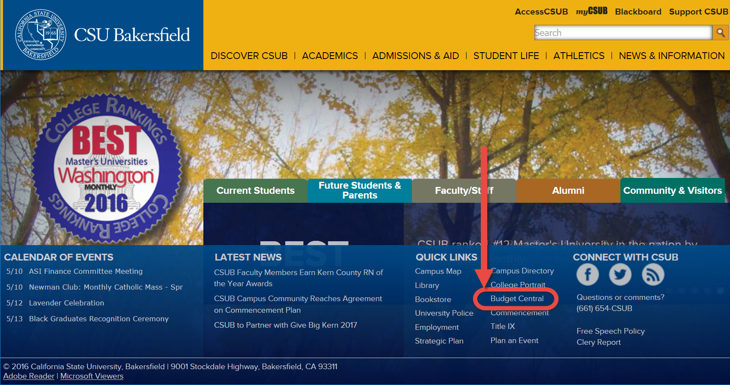

Slide 4
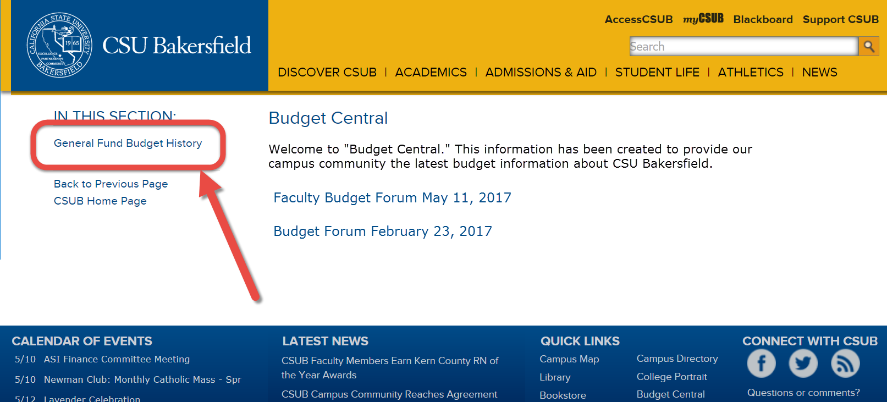

Slide 5
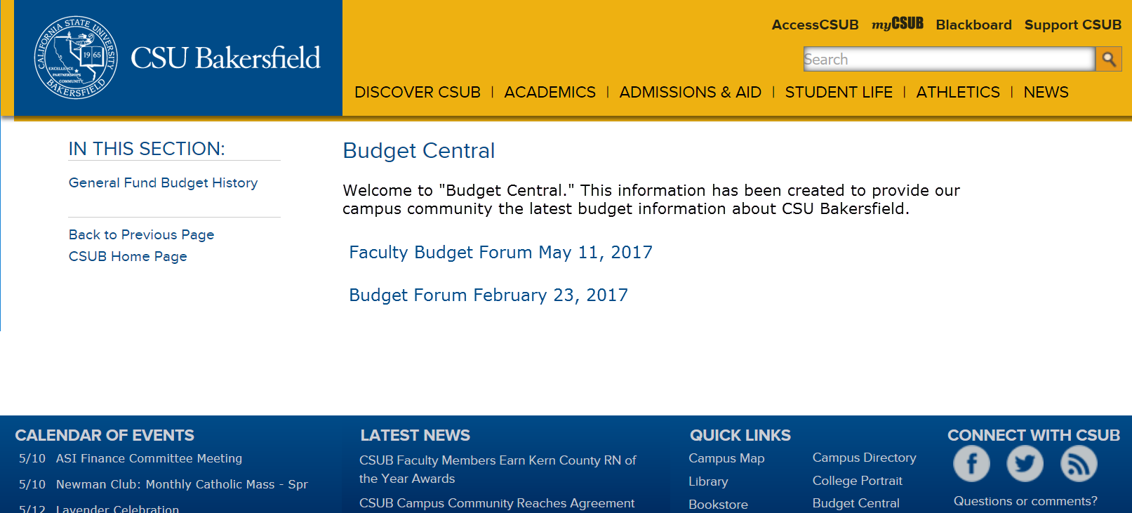
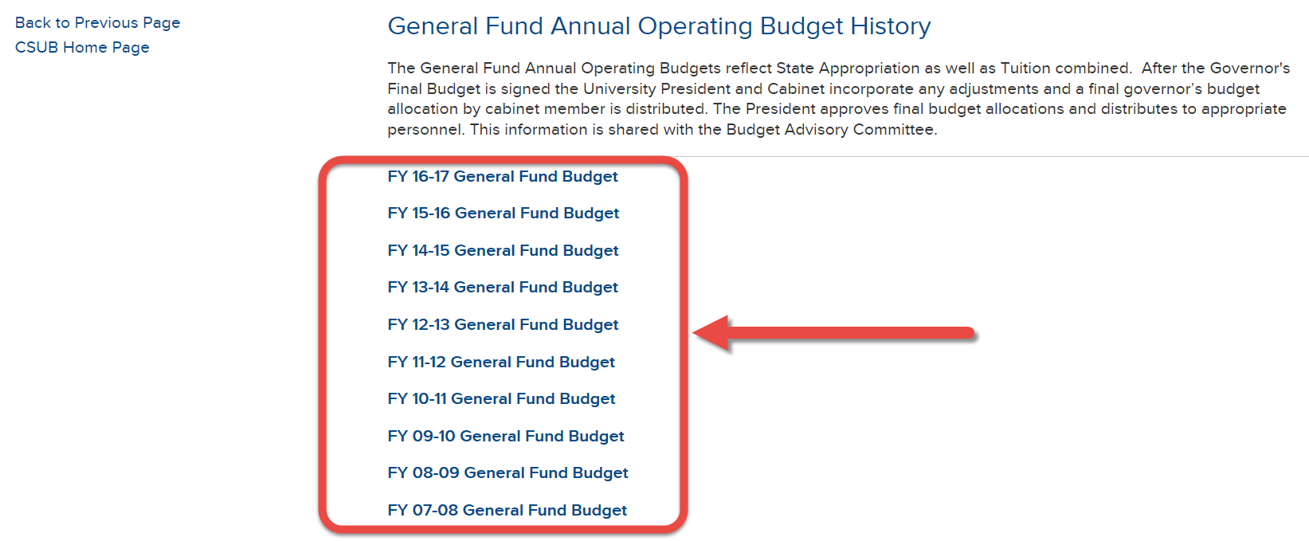

Slide 6
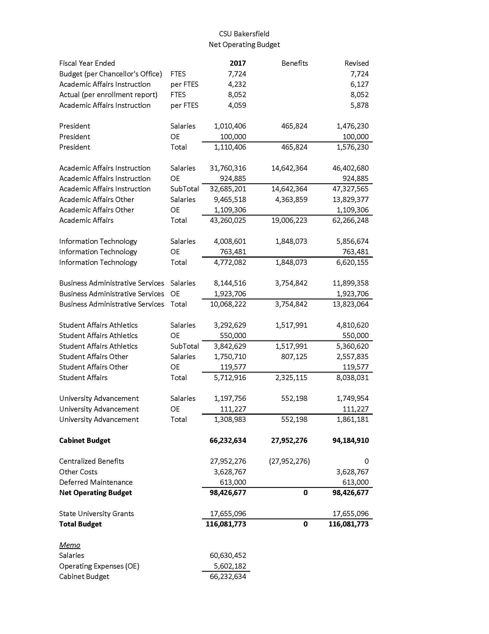

Slide 7
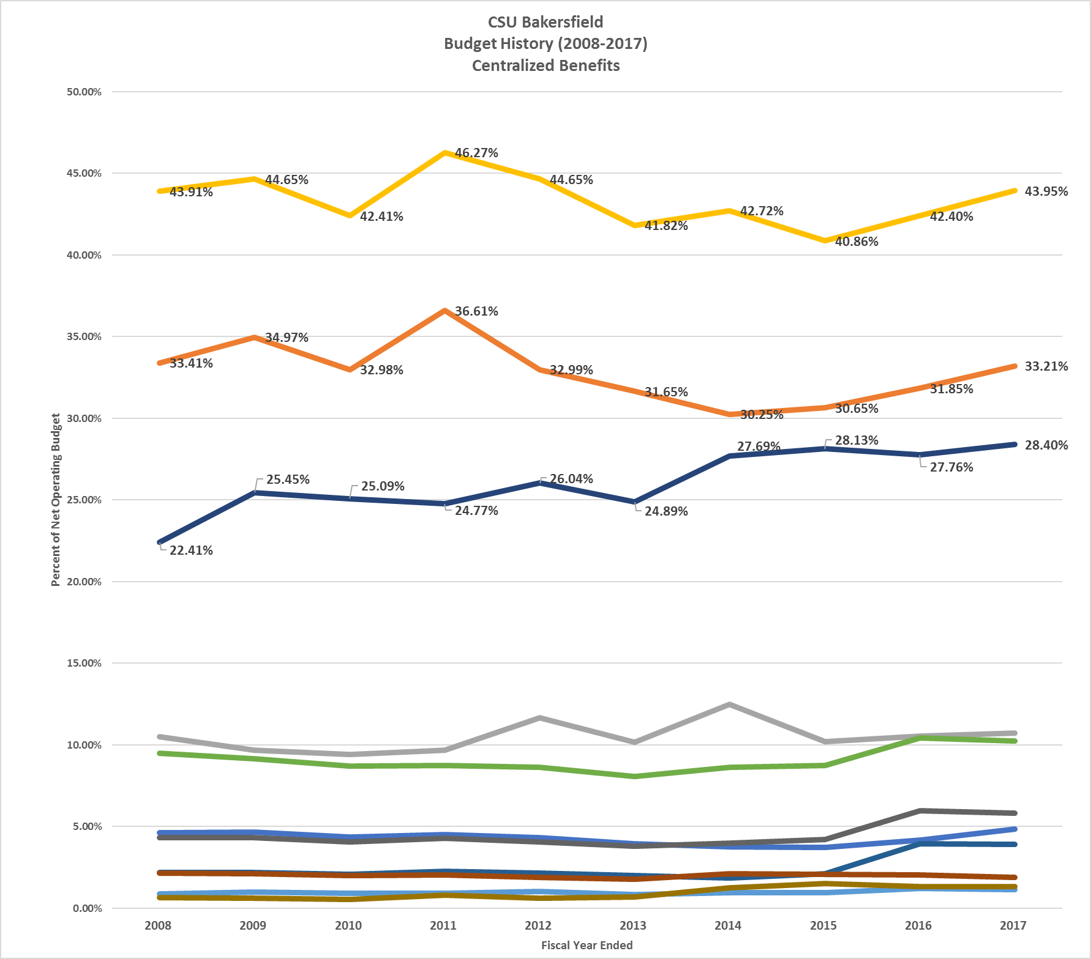
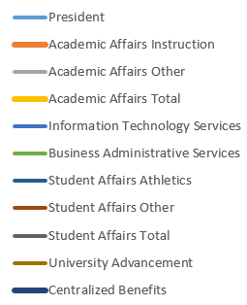

Slide 8
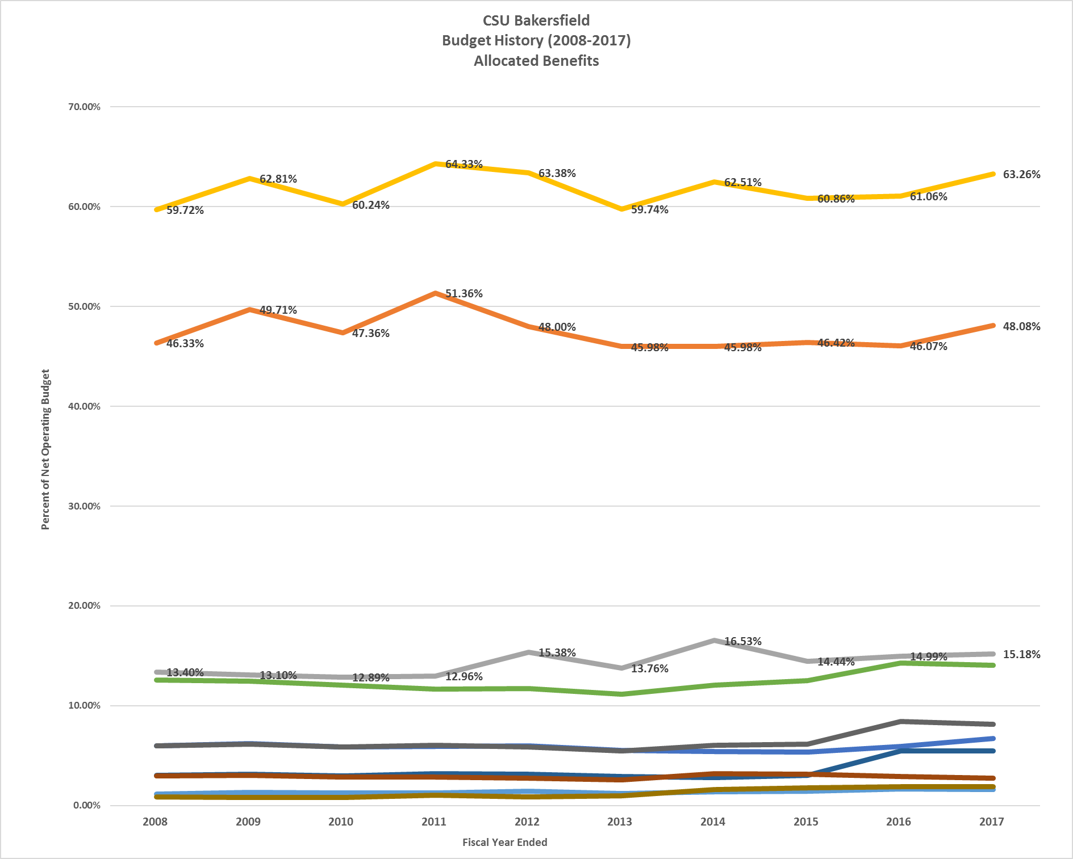
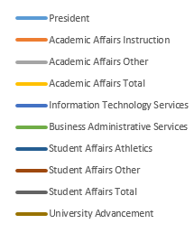

Slide 9
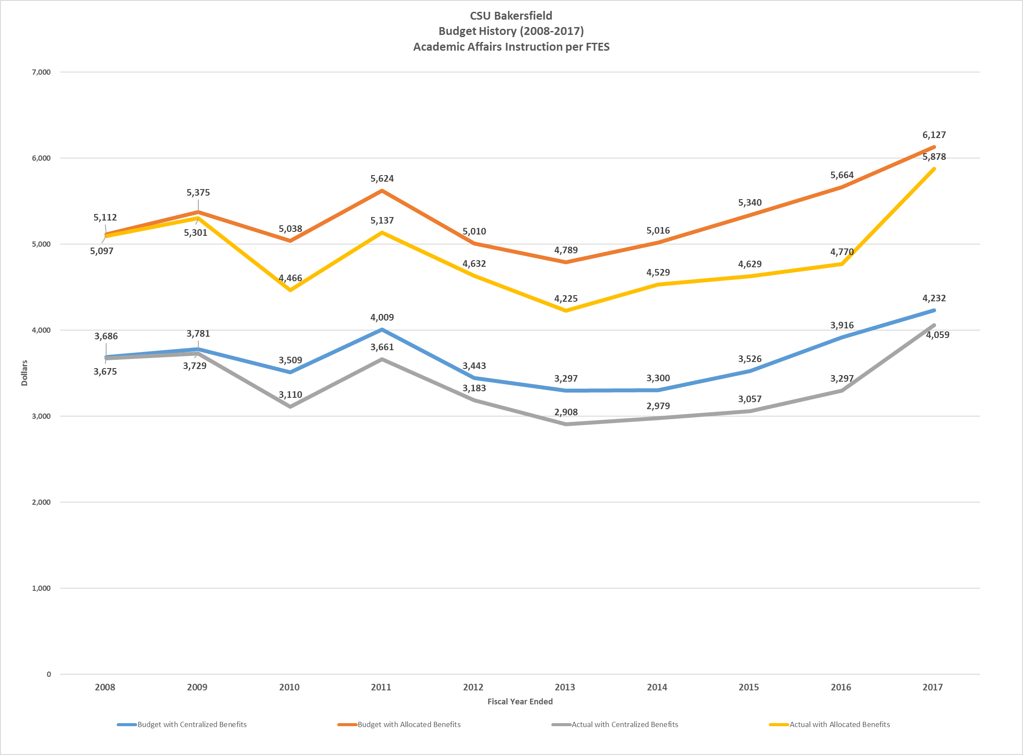

Slide 10
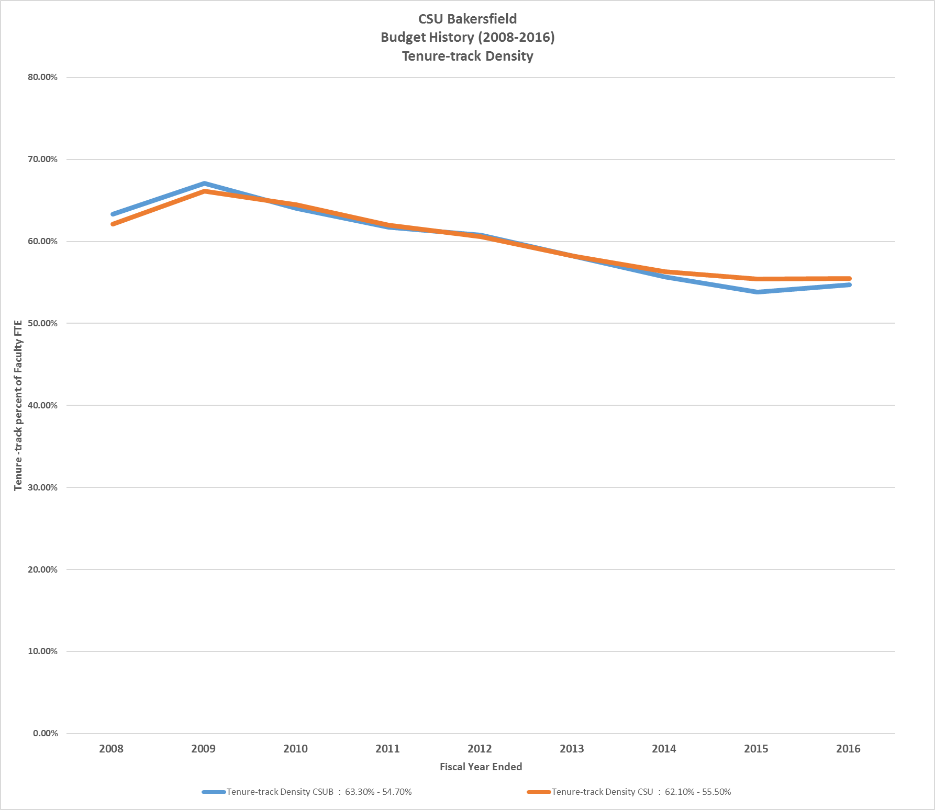

Slide 11
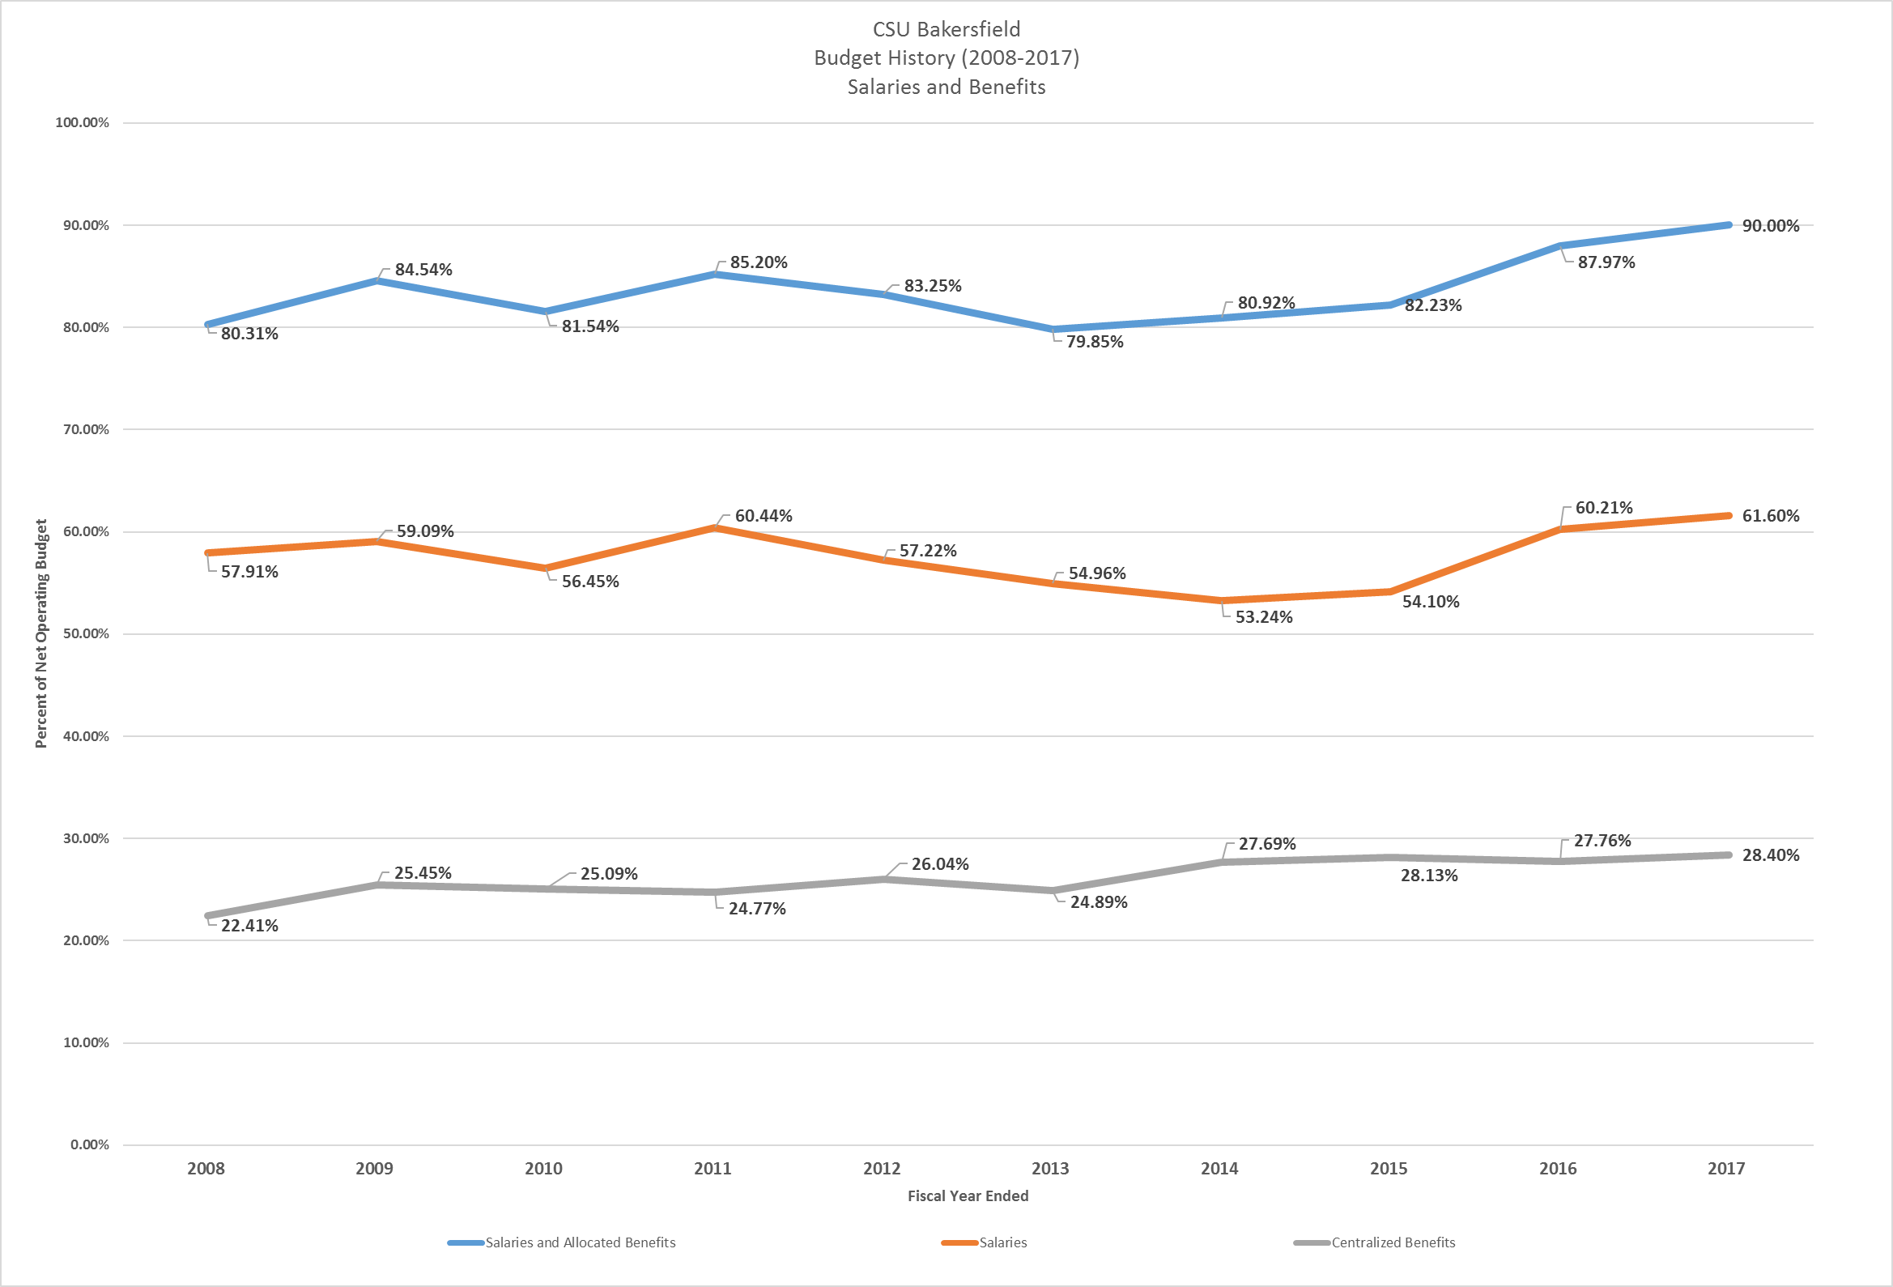

Slide 12
Budget Status
Fund-Department-Account
Position Control & Operating Expenses

Slide 13
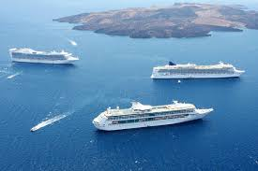
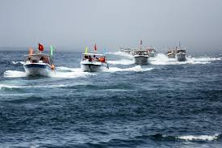
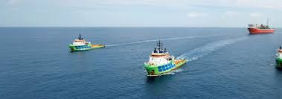
Question 1: WHERE is the money coming from?
Fund = Ship (within a family of ships)
BK=State Funds SP=Sponsored Program Funds MU=Non Mandatory Fee Funds

Slide 14

Question 2: WHO is spending the money?
Department = 2 Bedroom Suite (on the ship)

Slide 15
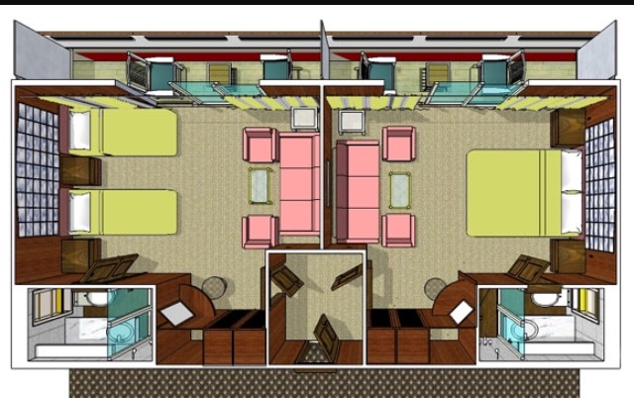
Question 3: WHAT is the money being spent on?
Account = Room (in the 2 bedroom suite)
Position Control l Operating Expenses

Slide 16
Budget Process
Input
Shared Governance / Consultation
Decision
Reporting (posted on-line)

