Slide 1

Campus Budget Forum
February 23, 2017
    Budget Central

Slide 2
Agenda
Introductions – Mitchell
  - Meetings of the USP-BAC
2016-17 Budget – Davis
2016-17 Critical Unmet Needs – Cabinet Members
New Initiatives
  Student employment
  Faculty and staff professional development
  Classroom and laboratory refresh and renovations
2017-18 BOT Budget Proposal – Mitchell
2017-18 CSUB Net Operating Budget Priorities
Summary
  - Advocacy Events
Discussion and Q & A

Slide 3
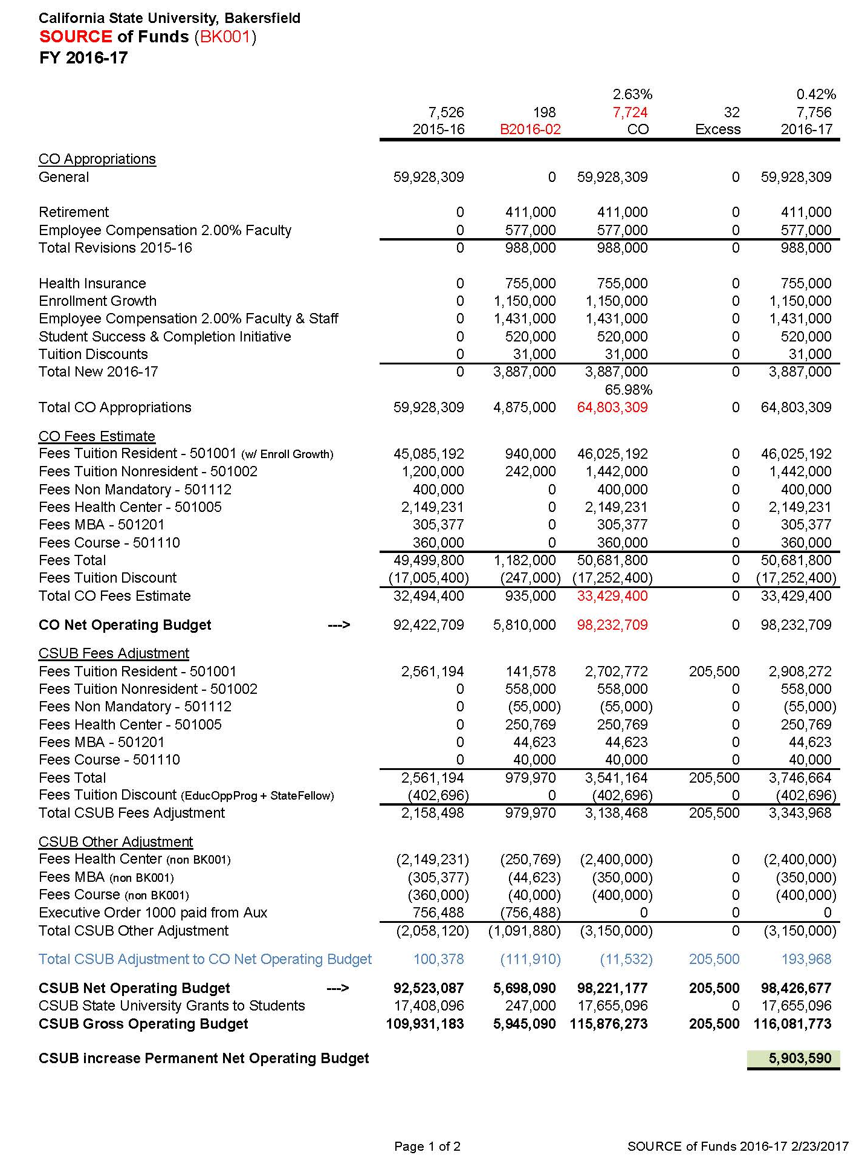
2016-17 Budget Source of Funds – FY 2016-17 (BK001)

Slide 4
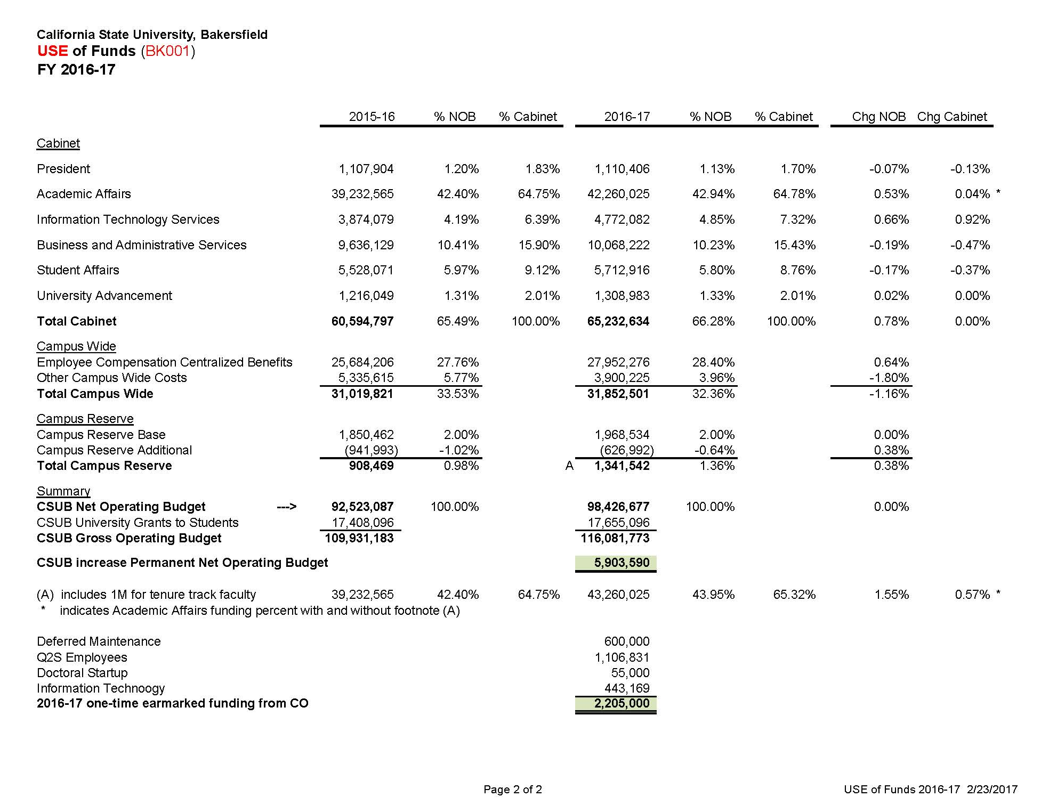
2016-17 Budget
Use of Funds – FY 2016-17 (BK001)
4

Slide 5
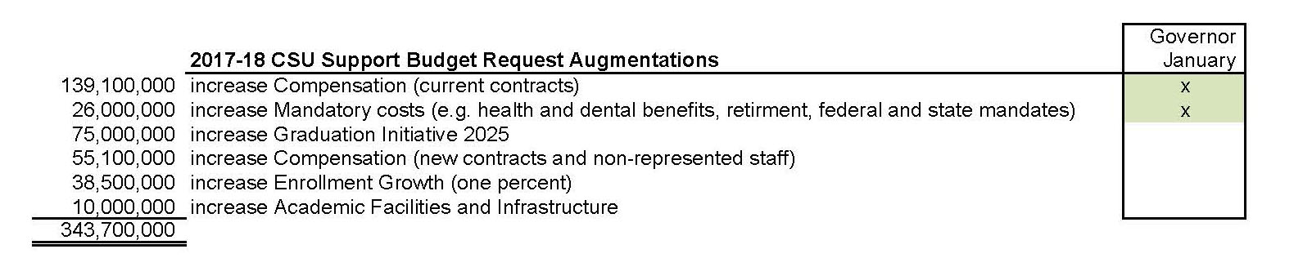
2017-18
CSU Support Budget Request Augmentation

Slide 6
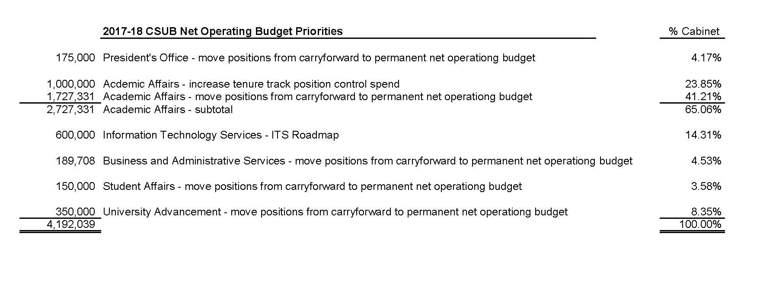
2017-18 CSUB Net Operating Budget Priorities

Slide 7
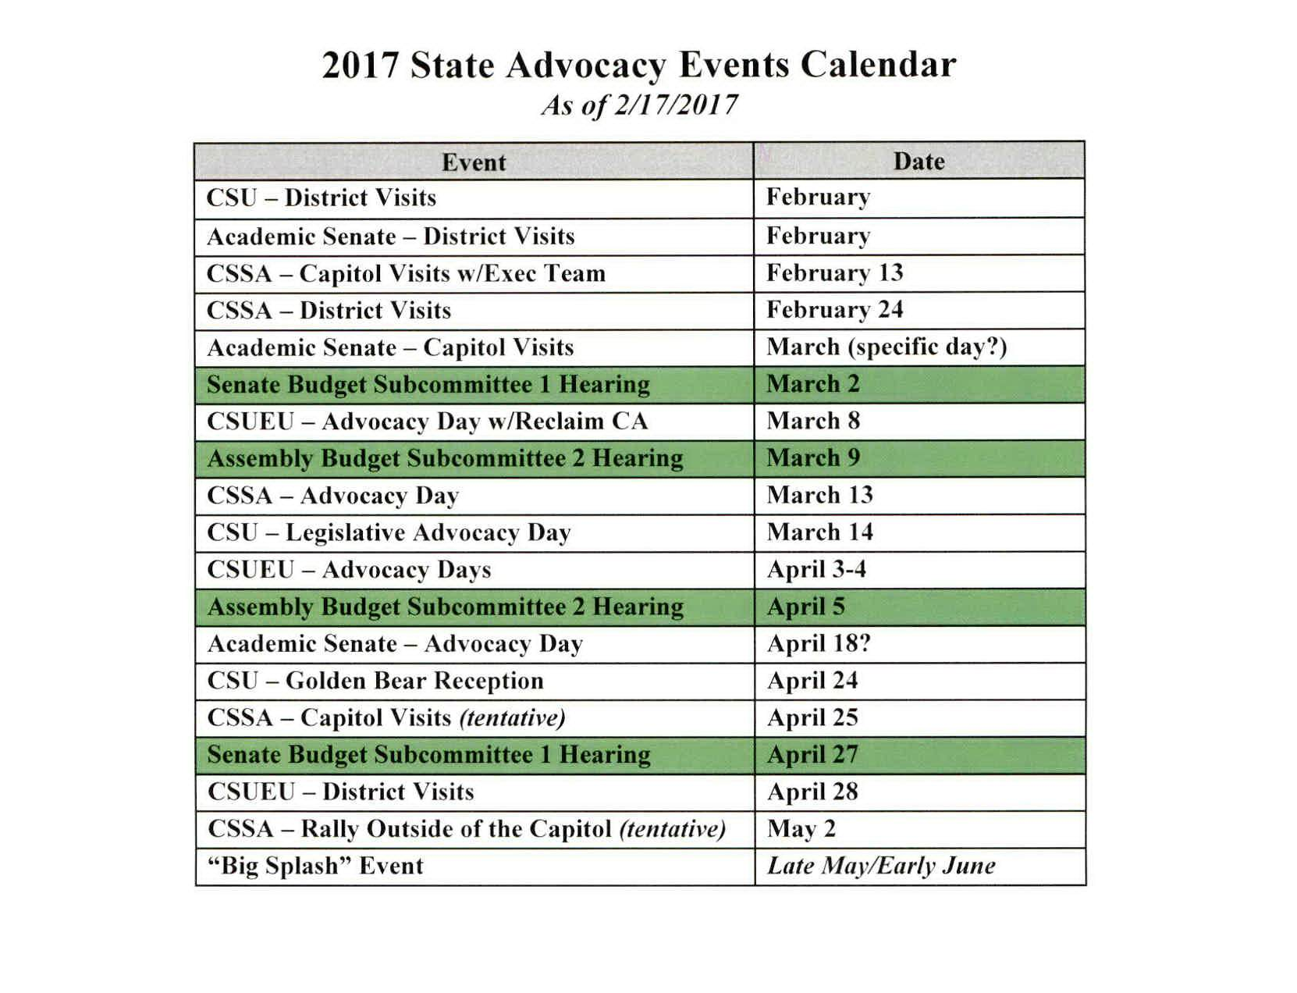
2017 State Advocacy Events Calendar

