Slide 1
The Energy and
Engineering Innovation Building
A Special Proposal for
Donor Name
February 9, 2022

Slide 2
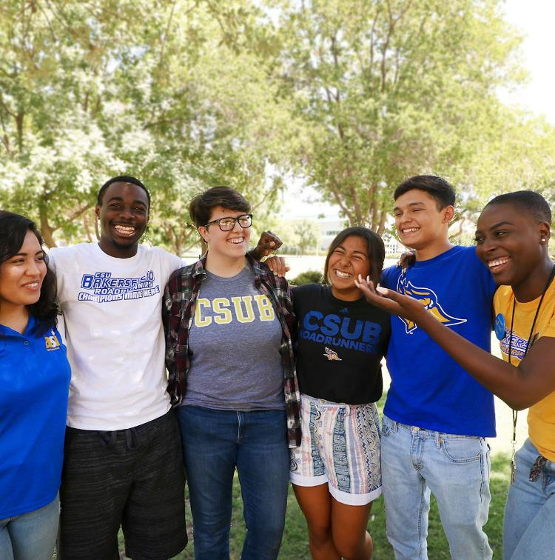
About California State University, Bakersfield
Centrally located on a 375-acre site in the southern San Joaquin Valley, California State University, Bakersfield is home to the Roadrunners — moving forward at lightning speed and championing intellectual progress. CSUB continuously rises in national rankings for its economic value and commitment to student success. Its students are brilliant and increasingly diverse — with the majority of graduates remaining in the Valley to solve our region’s complex challenges.
The university serves more than 11,000 students at either the main campus in Bakersfield or at CSUB Antelope Valley, and counts approximately 60,000 alumni from its four schools:
Arts and Humanities
Business and Public Administration
Natural Sciences, Mathematics and Engineering
Social Sciences and Education
The university offers 56 undergraduate and graduate programs. In addition, CSUB Extended Education offers a number of professional development opportunities, certificates and degree programs to the community.
As part of NCAA Division I, the university is home to 16 athletics teams competing in the Big West Conference.

Slide 3
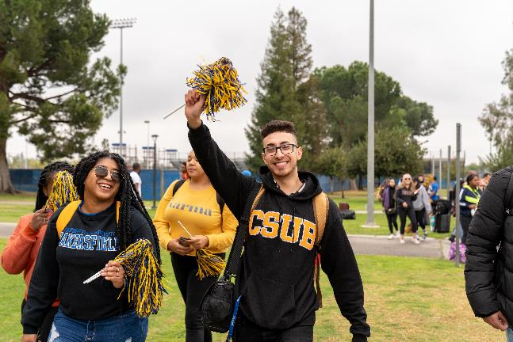
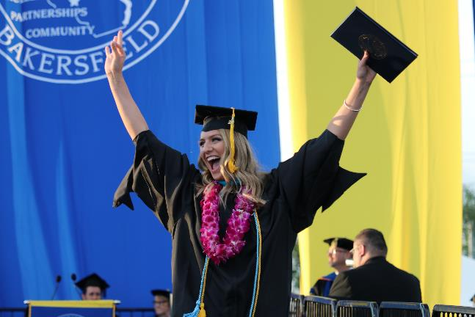
About NSME
Background
With over 200 faculty and staff, the School of Natural Sciences, Mathematics and Engineering (NSME) offers over 30 degree programs and serves thousands of students annually. CSUB is the only public four-year degree granting institution within nearly 100 miles, and NSME plays a pivotal role in meeting the STEM workforce needs of the region.
Mission
The School of NSME is dedicated to providing an outstanding educational experience consistent with the university’s mission, which is to be a comprehensive public university committed to offering excellent undergraduate and graduate programs that advance the intellectual and personal development of its students.
Vision for the building
The Energy and Innovation Building will be a state-of-the-art facility that supports modern, high-impact practices in teaching, interdisciplinary research and community outreach and partnerships. Teaching labs will enable us to grow our engineering programs to meet area needs for a STEM educated workforce; groundbreaking research collaborations between industry and NSME faculty and students will occur in specialized labs; and the Fab Lab and other event spaces will serve as the public gateway to the sciences at CSUB.

Slide 4
A Dramatic Progression
The School of NSME has made strategic additions since 2007 as part of its commitment to provide excellent graduate and undergraduate opportunities and programs.
Over 93% of the growth in the university over the past ten years has been in the sciences, with the number of STEM majors more than doubling to over 2,800 students in fall 2017.
New undergraduate NSME degrees include the B.S. in Biochemistry, Computer Engineering, Electrical Engineering, Engineering Sciences, Human Biology, and the RN to BSN in Nursing. New graduate degrees include the M.S. in Nursing.
The California Energy Research Center was launched in 2015 to serve as a clearinghouse of energy related expertise and to foster research collaborations between local industries and NSME.
The Fab Lab opened its doors in 2014, giving the entire community the chance to turn designs into reality through access to 3D printers, milling machines, laser cutters, and other high tech digital fabrication equipment.
K-12 education partnerships include dual credit high school courses, summer research programs for middle and high school students (REVS UP and REVS PUP), Science Fridays, and engineering days.
Regular NSME community science programing includes Fab Fest, Kinetic Sculpture Challenge, National Bioenergy Day, “Engineer it, Girl” (all in 2017).
A $6 million, five-year Department of Education grant (awarded 2016) launched the Pathways Program, a comprehensive approach to improving first-year science student success.
NSME faculty currently have almost $15M in grant funding awarded by a variety of local and government agencies from the National Science Foundation to the California Pistachio Research Board. This funding supports not only world-class research, but also transformative research experiences for students.

Slide 5

Leadership
Business and Innovation
List some qualities of the donor to highlight their outstanding leadership
On the right, include a photo of the donor and/or their company’s logo
Community Champion and Advocate
List some qualities of the donor to highlight their outstanding community support
Supporter of CSUB
List some qualities of the donor to highlight their support of CSUB

Slide 6
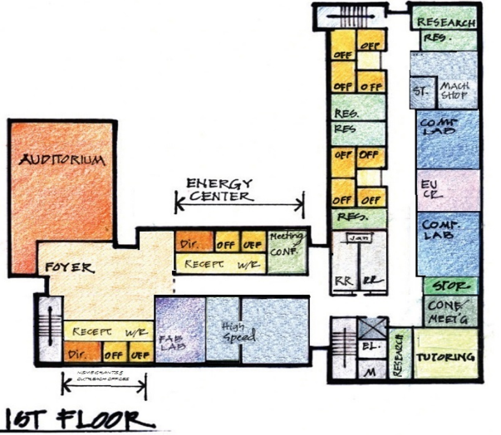
Energy and Engineering Innovation Building
The three-story Energy and Engineering Innovation Building will include:
Physics and Engineering Teaching Labs
Research Labs
A Machine Shop and Expanded Fab Lab
Auditorium-Atrium-Foyer
Faculty Offices
Support Spaces (meeting rooms, small classrooms, student study space, etc.)

Slide 7
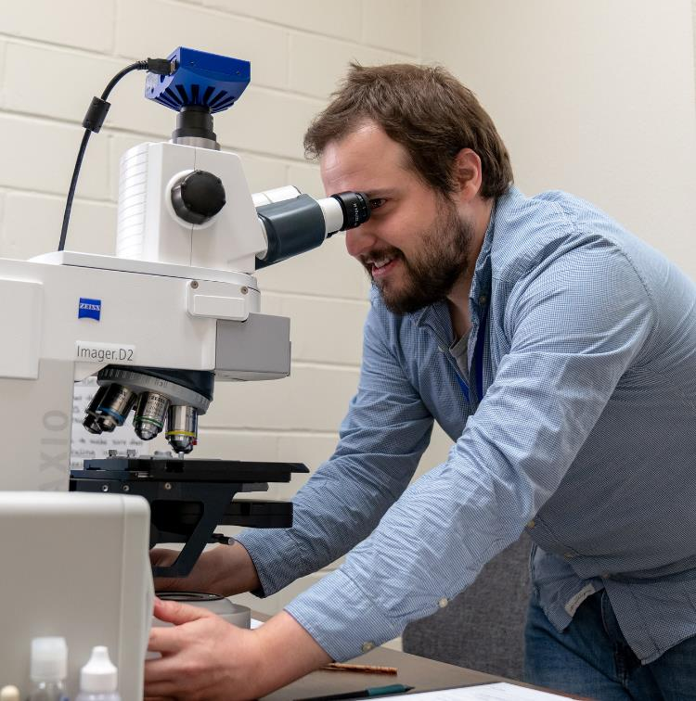
Endless Possibilities
The Energy and Engineering Innovation Building will make possible ...
Additional engineering degrees with an increase of faculty offices and specialized teaching labs.
Student access to high-impact, hands-on educational experiences that start with a first-year seminar kinetic sculpture project and other project based assignments made possible through the expanded Fab Lab and the California Energy Center Research Lab.
Joint industry-NSME research projects completed in the California Energy Research Center devoted to energy efficiency, natural gas safety, water purification, and any of a number of focused research questions developed in consultation and cooperation with area industries.
Increased grant funding through the activities of more CSUB faculty and students engaged in high-quality research.
An expansion of outreach activities in the expanded Fab Lab and special events in the auditorium-foyer-atrium event space.

Slide 8
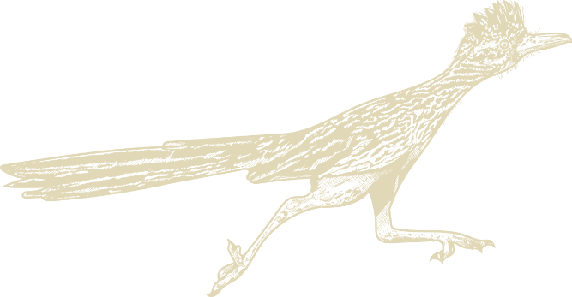
The Impact of Your Gift
01 To Individual Students
02 To CSUB
03 To The Community
Give talented, local young people an opportunity to pursue careers as engineers.
Ensure that as our programs continue to grow, students have the same access to:
  Transformative experiences (one-on-one instruction)
  Project based classes
  Research and internships that inspire and empower them
  Access to the best possible STEM education.
Inspire philanthropic participation from others at a time when the institution increasingly relies on local support.
Enhance CSUB’s reputation and lead it to even greater successes by providing spaces needed for a growing faculty to increase its contributions of scientific knowledge.
Enable the California Energy Research Center to realize its vision and mature from a handful of students and faculty working together across campus to a research hub bringing faculty, students, and industry partners together on interdisciplinary teams attacking local problems.
Provide local industries with a high-quality STEM workforce with roots in the community.
Increase the visibility and effectiveness of CSUB as a local resource for energy and engineering expertise.
Create more K-12 partnerships and opportunities for young people to catch the science “bug” in CSUB outreach programs, more special events, and more continuing STEM education opportunities.

Slide 9
Our Request for Your Support
We respectfully ask that you consider scheduling a meeting with President Lynnette Zelezny and Victor Martin.
Thank You
Victor Martin • Vice President for University Advancement • Executive Director, CSUB Foundation
California State University, Bakersfield • 9001 Stockdale Highway, 19AW • Bakersfield, CA 93311 • Cell: 661-444-5429

